Slide 1
Text analysis
Julia Lane
With many thanks to Rayid Ghani, Evgeny Klochikhin and Jordan Boyd Graber
Heavy use of ideas from David Blei’s website, particularly
http://www.cs.columbia.edu/~blei/papers/Blei2012.pdf ;
http://www.cs.columbia.edu/~blei/talks/Blei_Topic_Modeling_Workshop_2013.pdf
“Text as data” Matthew Gentzkow; Bryan Kelly, Matt Taddy, Journal Journal of Economic Perspectives, forthcoming

Slide 2
Key takeaways
Text is a useful resource to answer policy and research questions
Text data is very diverse and requires substantial processing
Data cleaning and processing are critical to success
The choice of the right method depends on the question and application
Evaluation is key to robust and valid results

Slide 3
Outline
Motivation
Definitions
Processing text data
Methods
Evaluation
Approaches and Applications

Slide 4
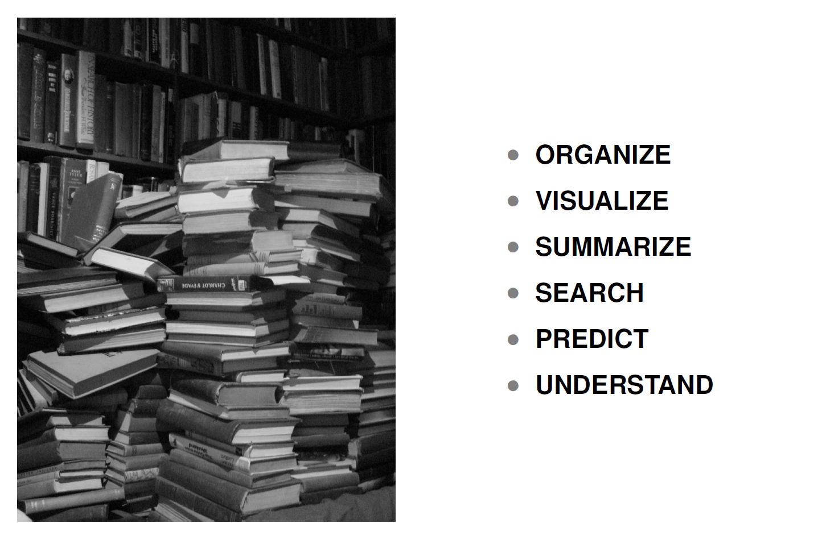
What can text mining do?
Capability | Description | Maturity
Classification | Classification of a document into one or more previously defined content categories. (e.g. Classify incoming emails as personal, business, news article, etc.) | High
Word Clustering / Synonyms | Finding groups of words that are similar to each other. Depending on the strictness of the definition of similarity, similar words can be synonyms (IBM, Deep Blue) or companies in similar industry (Oracle, Teradata) | Low
Topic Detection / Clustering | Finding emerging or existing topics in large amounts of text data. Clustering news articles can help detect emerging topics. | High
Opinion & Sentiment Analysis | Detection of sentiment and opinions in different levels of granularity (word, sentence, message). | Medium
Named Entity Extraction (People, Locations, Organizations) | Recognition, tagging, and extraction of named entities of type Person, Location, and Organization. Typically limited to proper nouns and not much customization possible. | High
General Extraction (Entities, Events, Facts, Relationships) | Recognition, tagging, and extraction of specified classes of words /phrases as an entity (client, competitor, company), event (acquisition), relationship (John King works for MSFT) | Low
Search | Ranked retrieval of a document or component based on the presence of one or more supplied search terms. | High
Visualization | Visualization of text data and /or visual mashups combining text with other forms of data (maps, networks, etc). | Medium
Summarization | Summarization of a document, intended to produce a readable abstract of the source document which captures salient points using fewer words. | Low
4
Notes:
Add entity extraciont separate

Slide 5
Different approaches
 | Lexicon-based Rules | Linguistic Rules | Statistical Machine Learning (augmented with linguistics & lexicons)
Description | Rules based on lists of words | Rules using words and linguistic operators (parts of speech for example) | Statistical approaches that can be trained and learn over time. Can incorporate lexicons and linguistics as well
Ease of creation & maintenance | Low | Low | High
Accuracy | Low | Medium | High
Context Sensitiveness | Low | High | High
Interpretability | High (unless the rules get large) | Medium | Medium
Do it by hand
Hire linguists
Do it the right way

Slide 6
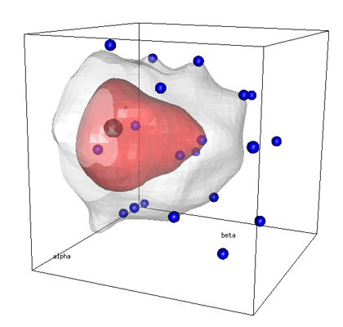

Statistical Machine Learning based approaches compensate for the shortcomings of rule-based systems
Model Training
Operational Use
“Is this blog about iPhones?”
“Is this blog about iPhones?”
Training Set
New Messages
✓
?
✗
Statistical Learning Algorithm
Machine Learning Model
✗
?
✓
✗
Model Trainer / Reviewer
Model Trainer
?
✓
✗
Lexicons
Update Model
Benefits of Machine Learning
Significantly cheaper approach to achieve a given level of accuracy compared to manual rule or lexicon creation
No advanced linguistic or technical skills to train and maintain the system (business users or analysts are the maintainers)

Slide 7
Does it have to be BIG data?
Words are a universe of meanings and context:
one word is often enough to effectively communicate the message
Documents bear different importance:
several directives and laws can cover an overlook of a subject area better than thousands of background notes
The more documents the more confusing the message:
depends on context and application but generally cleaner datasets will convey cleaner messages

Slide 8
How is text different?
Text is inherently high-dimensional.
Suppose that we have a sample of documents, each of which is w words long, and suppose that each word is drawn from a vocabulary of p possible words. Then the unique representation of these documents has dimension pw. A sample of 30-word Twitter messages that use only the 1,000 most common words in the English language, for example, has roughly as many dimensions as there are atoms in the universe.

Slide 9
Implication – You Know How to Do This!
Statistical methods used to analyze text are closely related to those used to analyze high-dimensional data in other domains, such as machine learning and computa-tional biology.
Some methods, such as lasso and other penalized regressions, are applied to text more or less exactly as they are in other settings.
Other methods, such as topic models and multinomial inverse regression, are close cousins of more general methods adapted to the specific structure of text data.

Slide 10
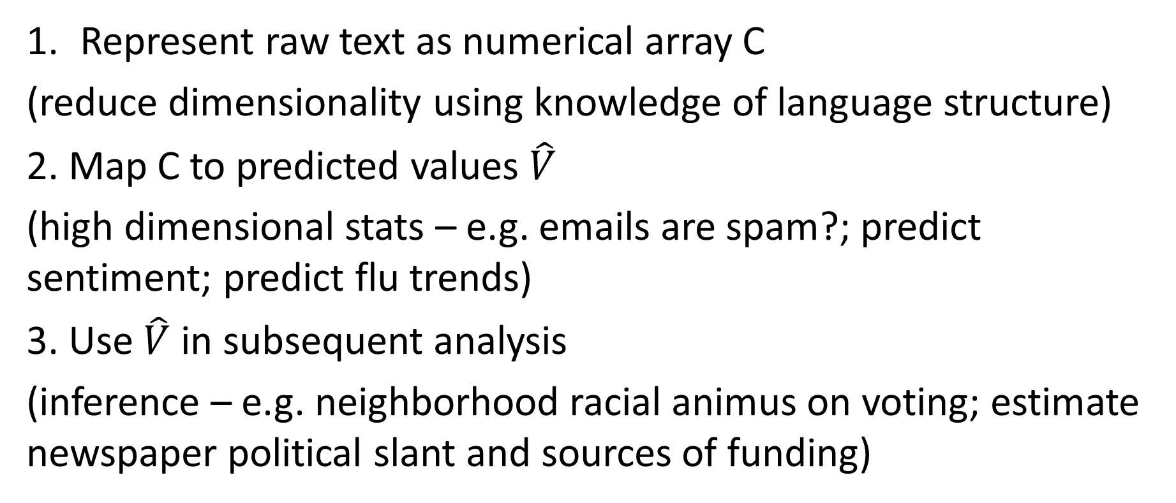
Three core steps
Represent raw text as numerical array C
(reduce dimensionality using knowledge of language structure)
2. Map C to predicted values $\hat{V}$
(high dimensional stats – e.g. emails are spam?; predict sentiment; predict flu trends)
3. Use $\hat{V}$ in subsequent analysis
(inference – e.g. neighborhood racial animus on voting; estimate newspaper political slant and sources of funding)

Slide 11



…And conservatively $14.1 billion ($2010) in economic burden from foodborne infectious illnesses alone.
In a typical year…
48 million cases (29-71 million)
128,000 hospitalizations (63,000-216,000)
3,000 deaths (1,500-5,000)
Source: CDC 2011

Slide 12
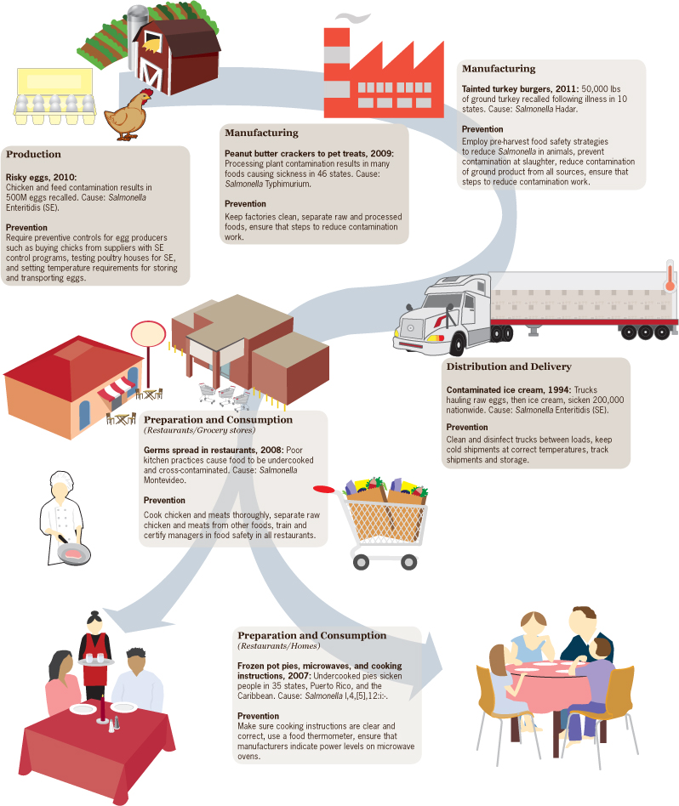
Food Safety Research’s Scope Spans the Complete Farm-to-fork Chain
Production: Animal husbandry, pathogen survival in crops, breeding, veterinary epidemiology, storage technology
Processing: pathogen and chemical detection, equipment engineering, food chemistry, management processes,
Preparation: impacts of new preparation technologies on safety, personnel management and training
Shipping and distribution: storage and refrigeration technology, pathogen detection, temperature abuse detection, information systems
Consumption: consumer food handling practices, information technology and communication, illness reporting systems, “restaurant” regulation, and epidemiology
Source: CDC 2010

Slide 13
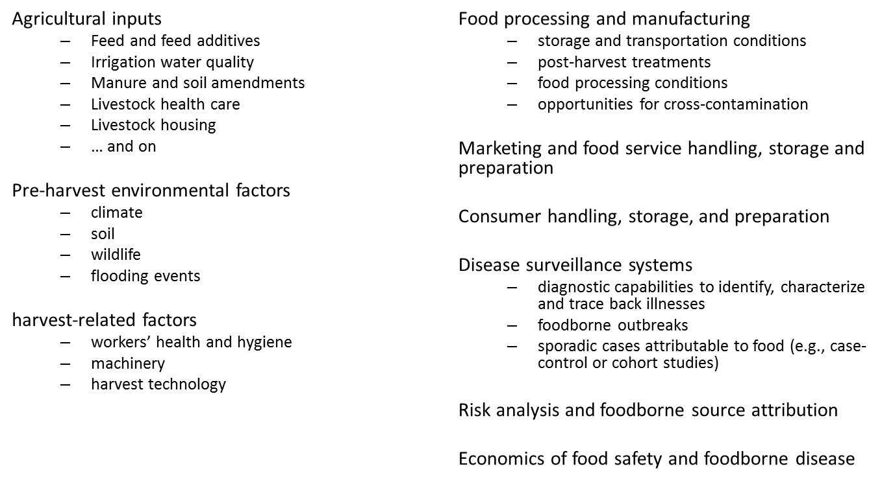
Food Safety Research’s Scope Spans the Complete Farm-to-Fork Chain

Slide 14
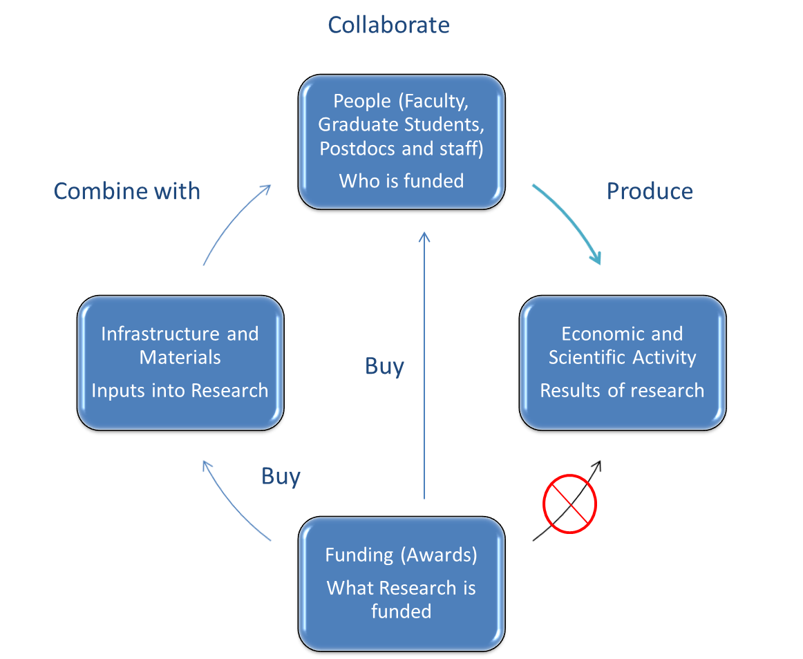
Step 1: Describing food safety grants

Slide 15
Text analysis of research documents to identify food safety
Two approaches
“Search term”: Expert-proposed search terms
“WikiLabel”: Map from “Food Safety” Wikipedia page to form a compact set of related terms
Implementation of both search strategies uses natural language processing (LDA) and human validation

Slide 16
Example: NSF (2000-2013) N=154,925
BREAD: Improving Water Acquisition in Maize with Root Traits that Reduce the Metabolic Cost of Soil Exploration
Collaborative Research: A Pilot Project on Interactive Land Use and Climate Predictions
Molecular and Cellular Biology of Biotrophic Interactions in Rice Blast Disease
SBIR Phase II: SaaS-Based Procurement and CRM Systems for Local Food Markets
NIRT: Building Capacity for Social and Ethical Research and Education in Agrifood Nanotechnology
BE/GEN-EN: Development of Methods Linking Genomic and Ecological Responses in a Freshwater Sentinel Species
Environmental Implications of Engineered Nanomaterials on the Important Environmental Model Daphnia
Workshop on Modeling the Rapid Evolution of Infectious Diseases
The Genetic Architecture of Adaptation in Laboratory Yeast Populations
Cell-to-Cell Signaling in E. Coli
WikiLabeling – 5,075 docs
Search term approach –
4,132 docs
562
SBIR Phase II: A Microfluidic-Based Biosensor for Food Pathogen Detection
STTR Phase I: Engineered Bacteriophage Based Biosensor for Rapid Detection of Viable Foodborne Pathogens
Biotechnology and Bioinformatics Program: The Institute For Food Safety
Workshop on Genomic Analysis of Plant-Associated Microorganisms; Washington, D.C., April 9 - 11, 2002
Dosage dependent genes affecting seed composition and weight

Slide 17
Insights from Topic Modeling
Source: Table 4.2: Measuring the Economic Value of Research
Notes:
The NSF mostly funds biological science and technology-focused food safety research

Slide 18
Notes:
NIH focuses on bacteriology, biochemistry, and the medical aspects of food safety

Slide 19
Notes:
USDA funds research directly related to food science, food microbiology, and farm-to-table projects

Slide 20
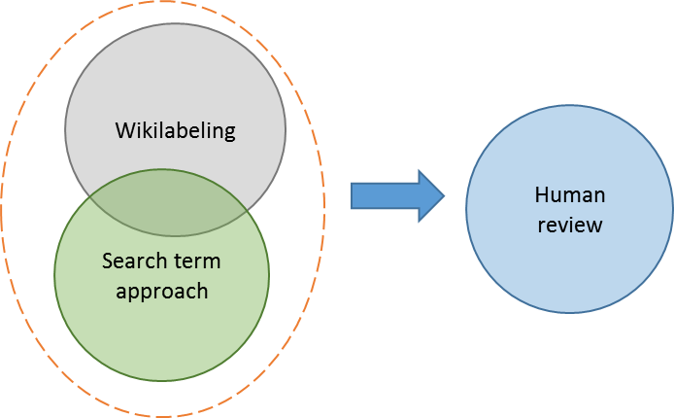
Adjusting approach

Slide 21
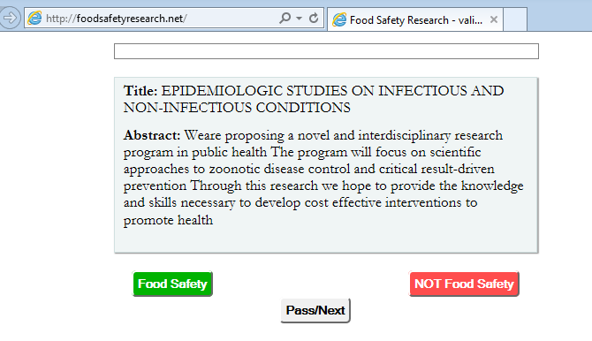
Crowdsourcing human validation: http://foodsafetyresearch.net
Cf. Diamond, Mortenson, Pissarides

Slide 22
Crowdsourcing human validation: http://foodsafetyresearch.net
PLEASE TRY IT !
foodsafetyresearch.net
Cf. Diamond, Mortenson, Pissarides

Slide 23
Counts of Grants by (Federal Agency) and Type (Food Safety Classiﬁcation)
Table 5.1: Measuring the Economic Value of Research

Slide 24
Another Example:

Slide 25
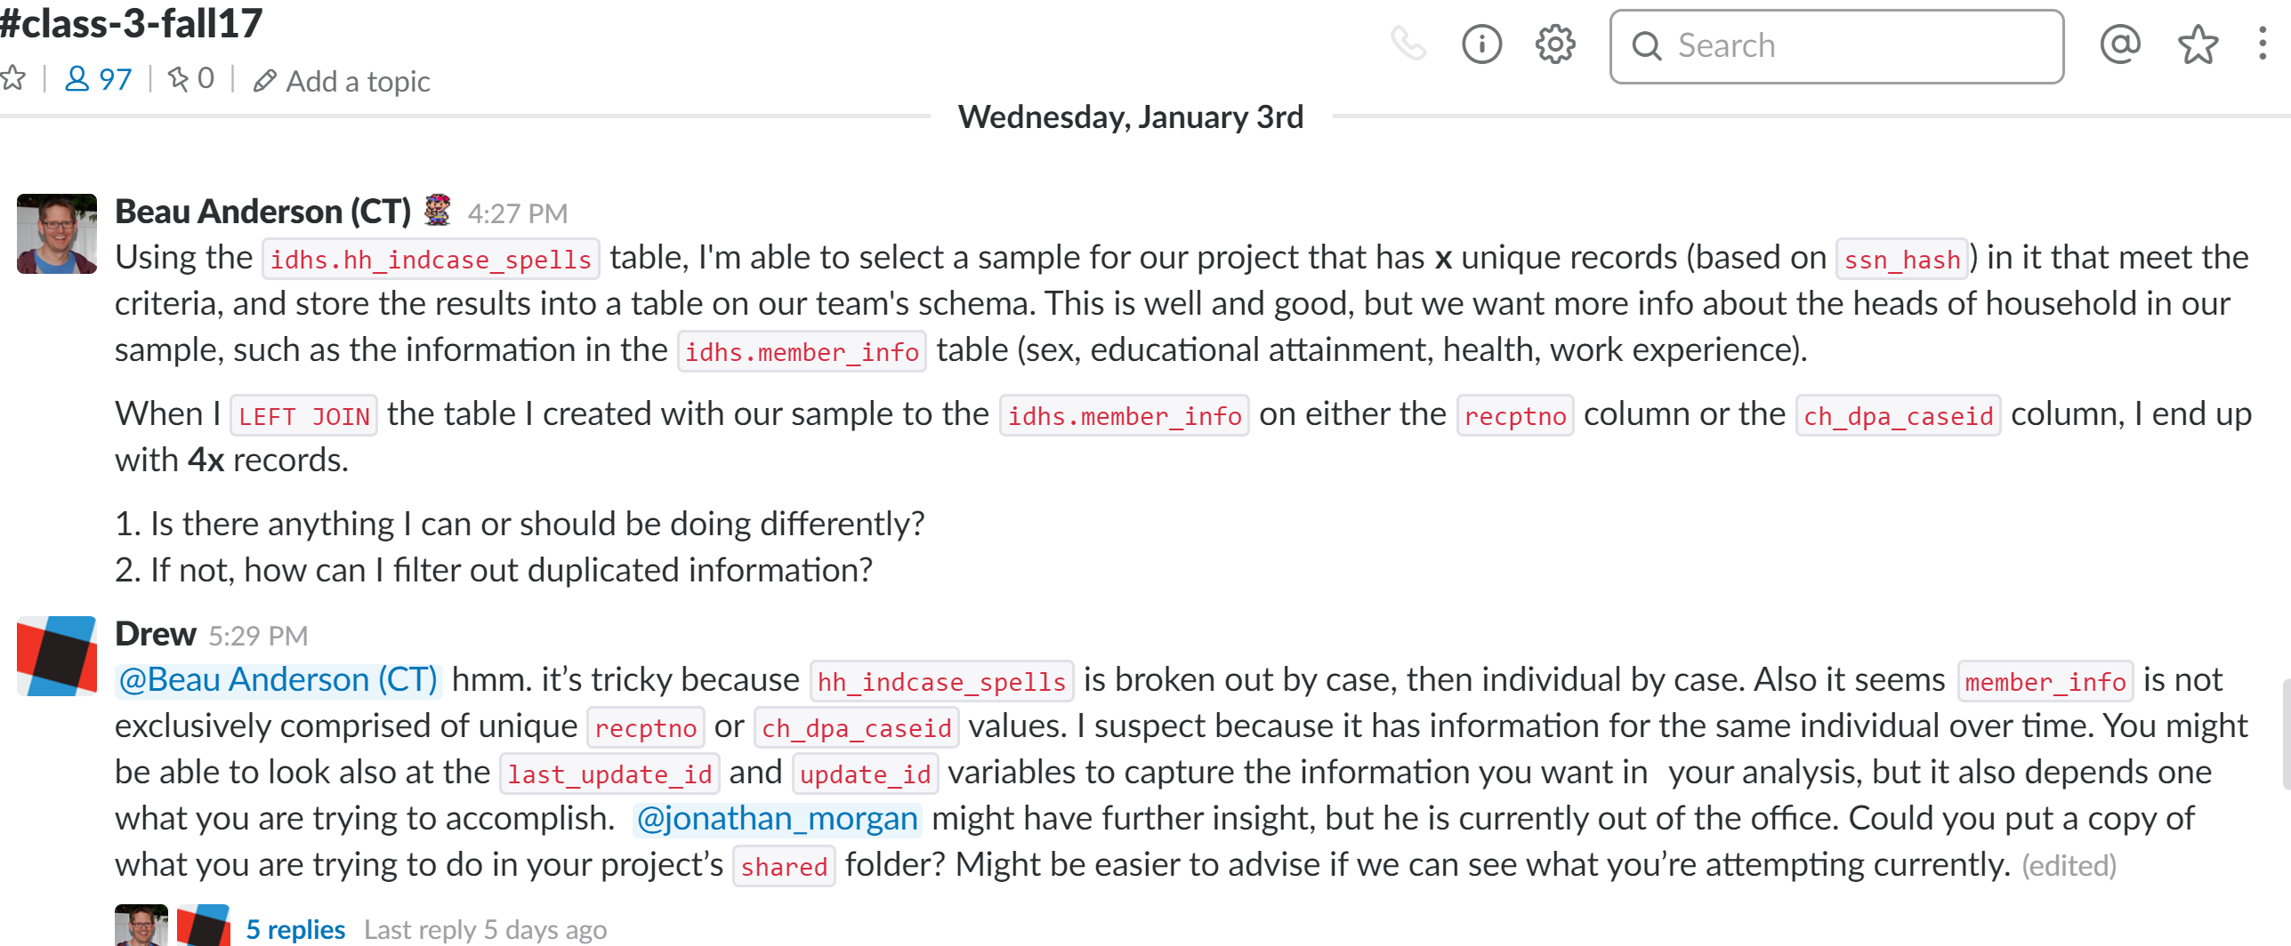
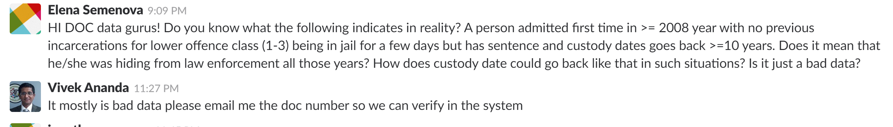
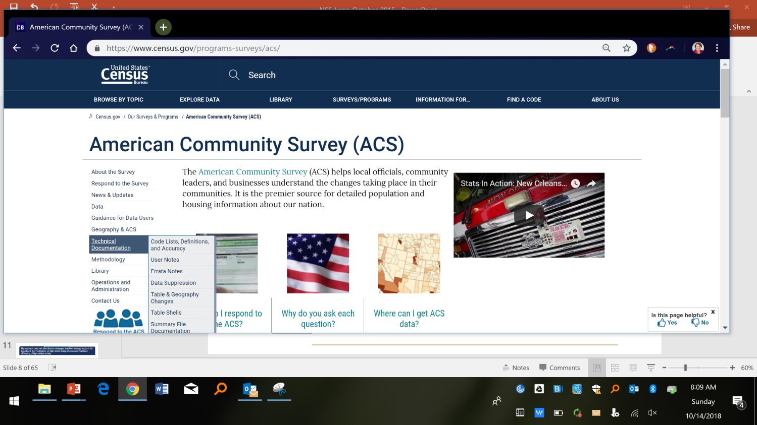
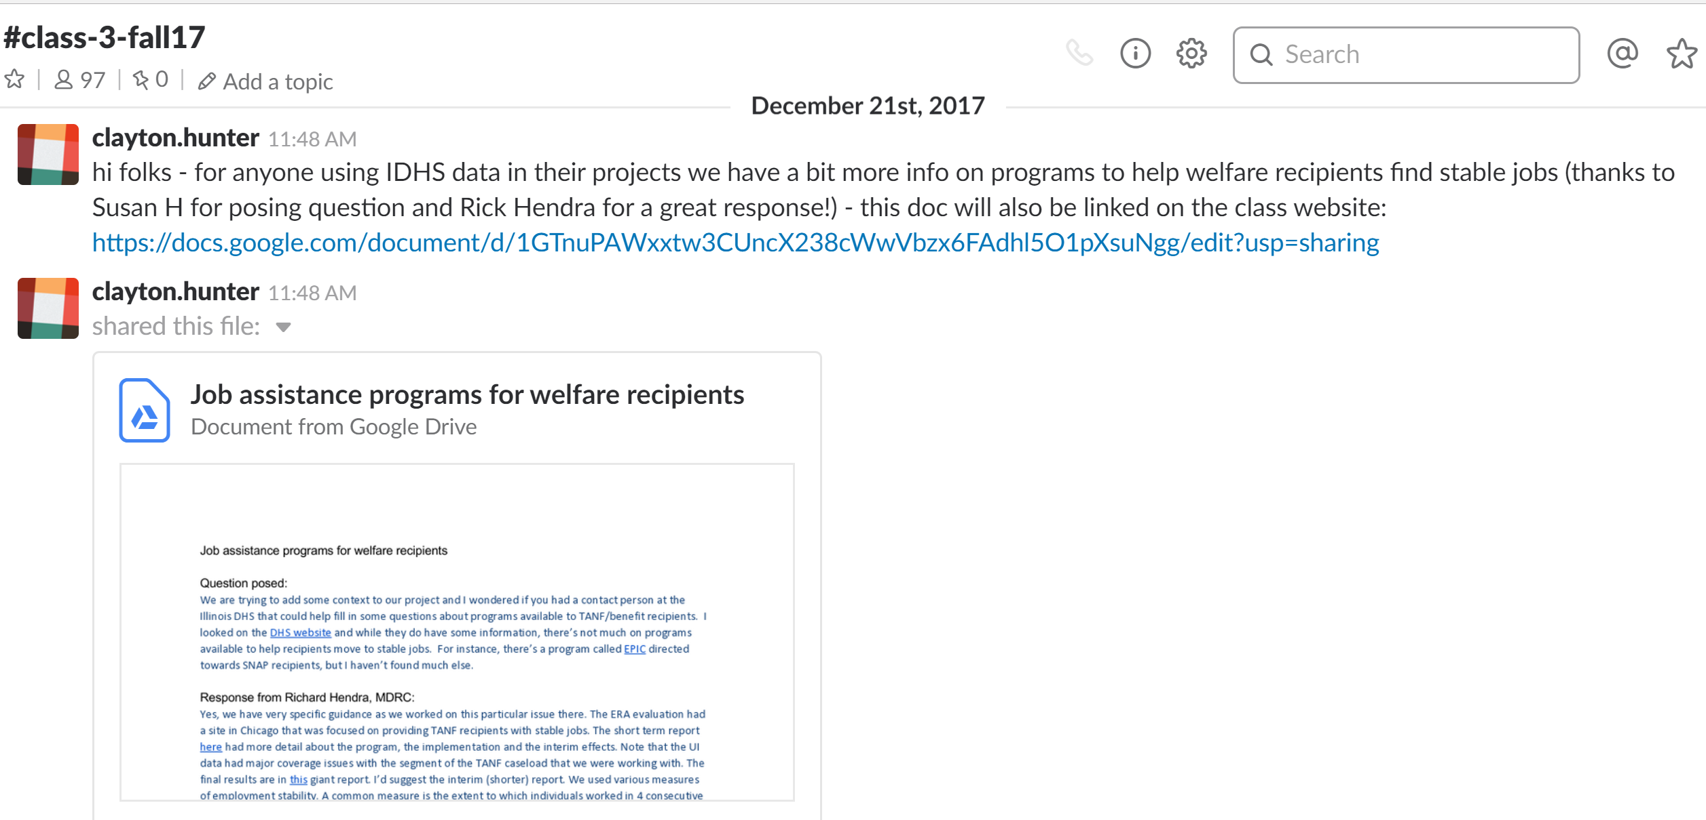
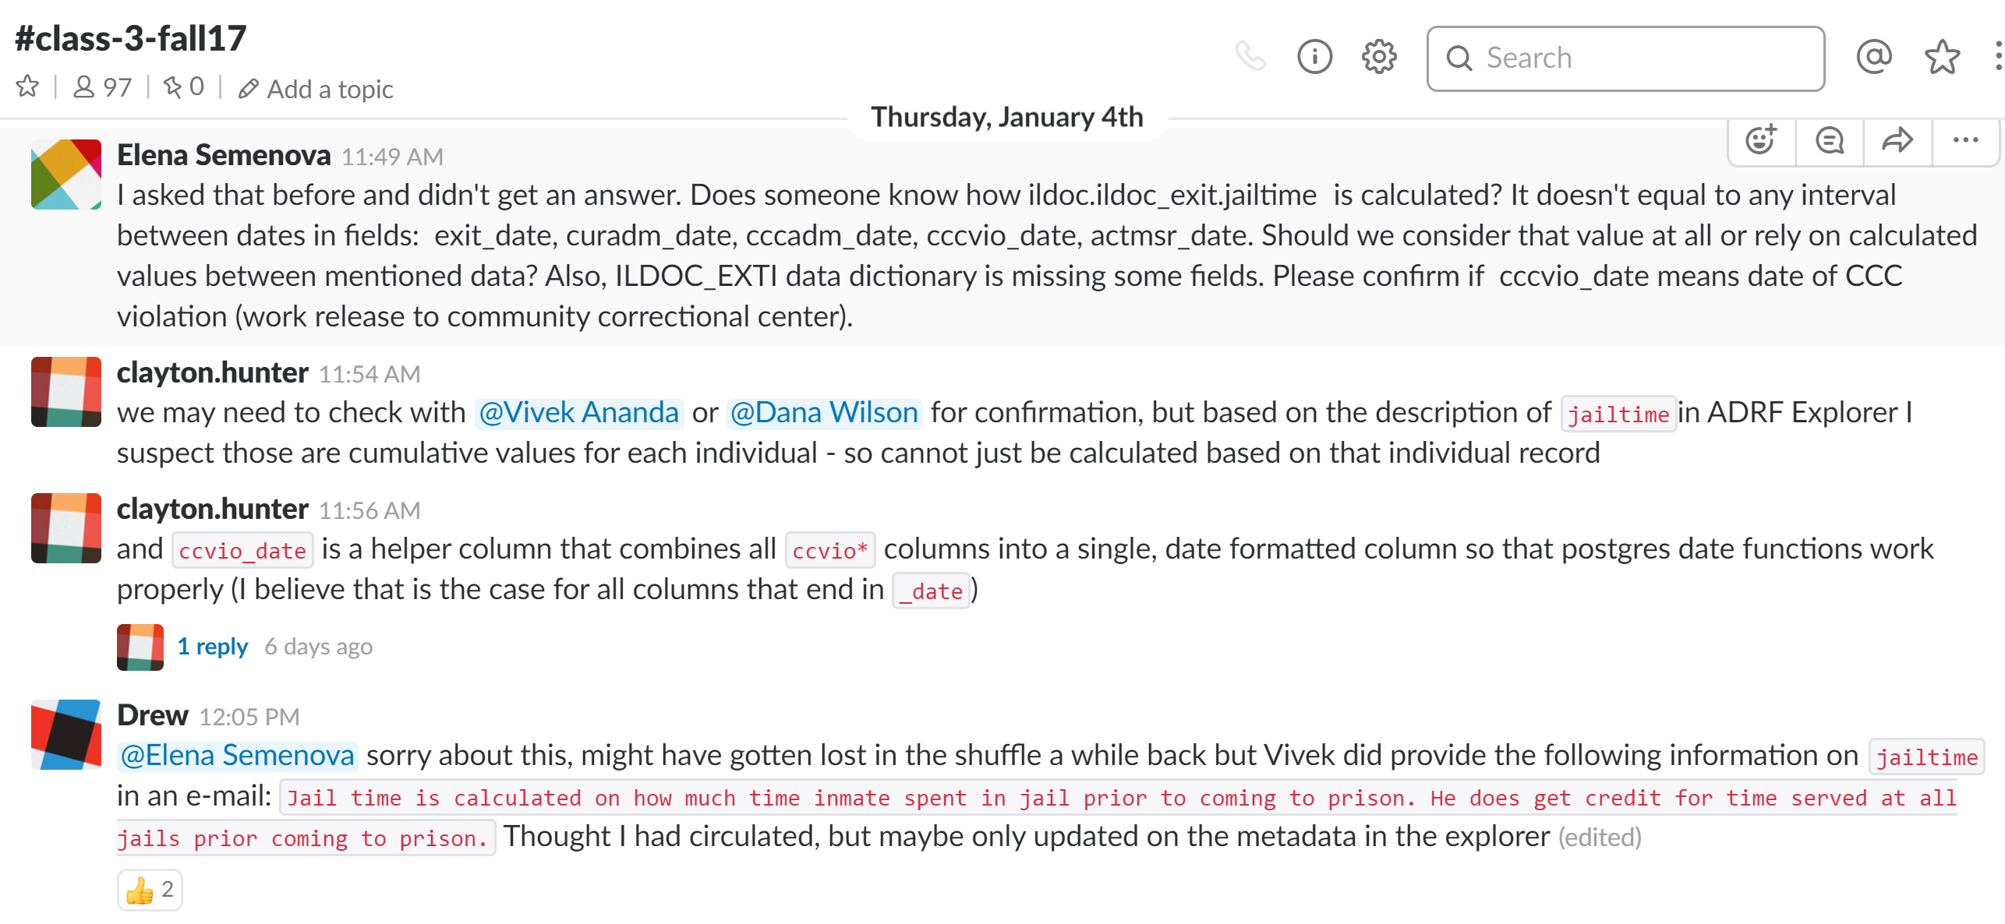
Almost no knowledge about data

Slide 26
Rich Context
Find, for a given dataset, who else worked with the data, on what topics and with what results
Create community that contributes code and knowledge

Slide 27


Search and Discovery
Related to data you've viewed
New data similar to data you've used
What others have done with similar data (recipes)
Recipes like yours
Thank you Charlie Catlett

Slide 28
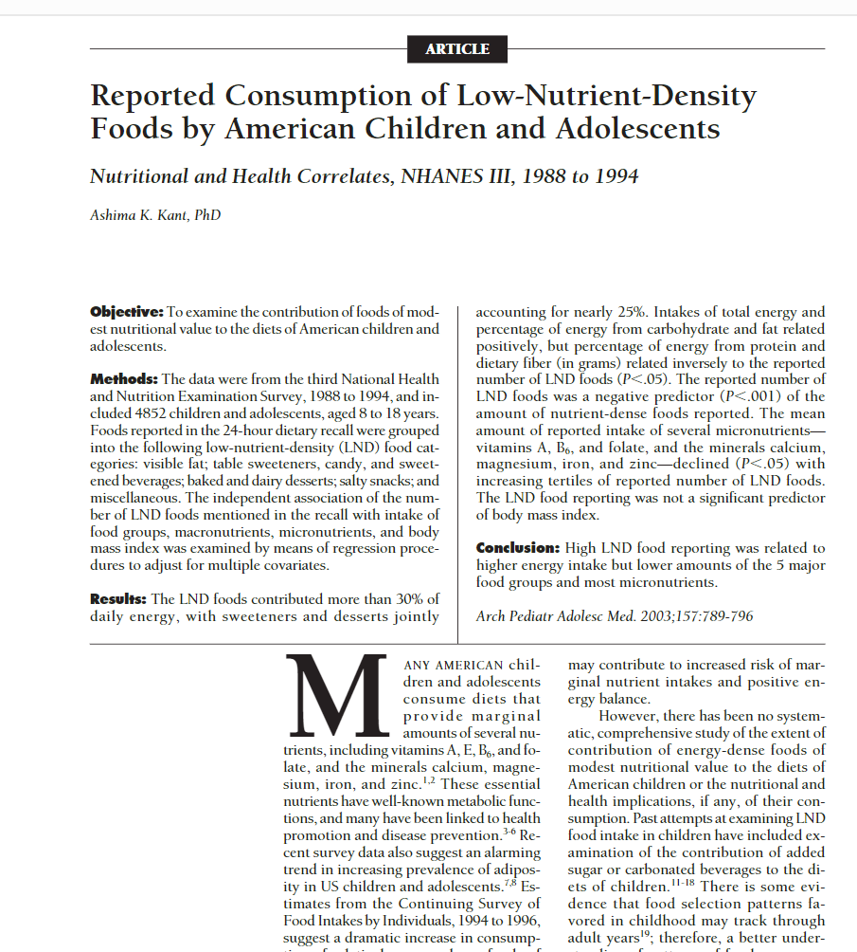
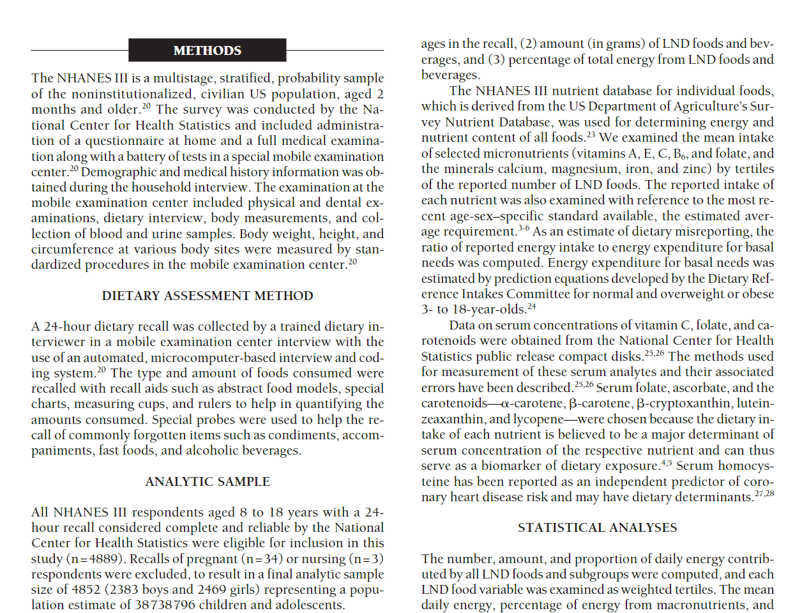
Point to data in article

Slide 29
Approach
Step 1: Create the set of corpora and metadata (computer science technology) - Competition
Step 2; Figure out how you learn from it and automate it (machine learning techniques) - Engagement
Step 3: Gamification – recognize and emphasize patterns (with human curation) – Rinse and repeat

Slide 30
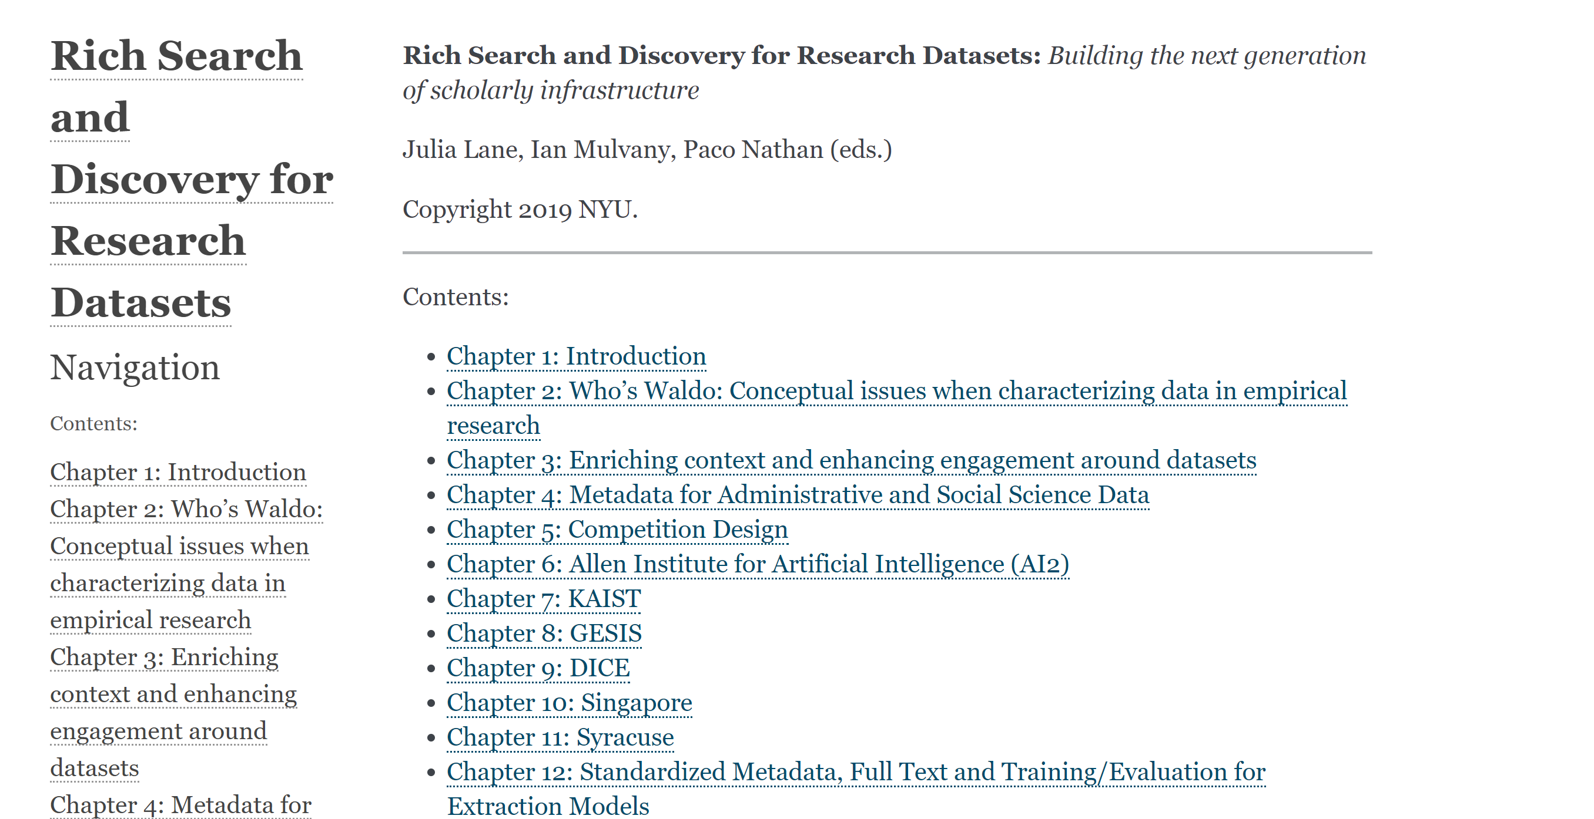

Slide 31
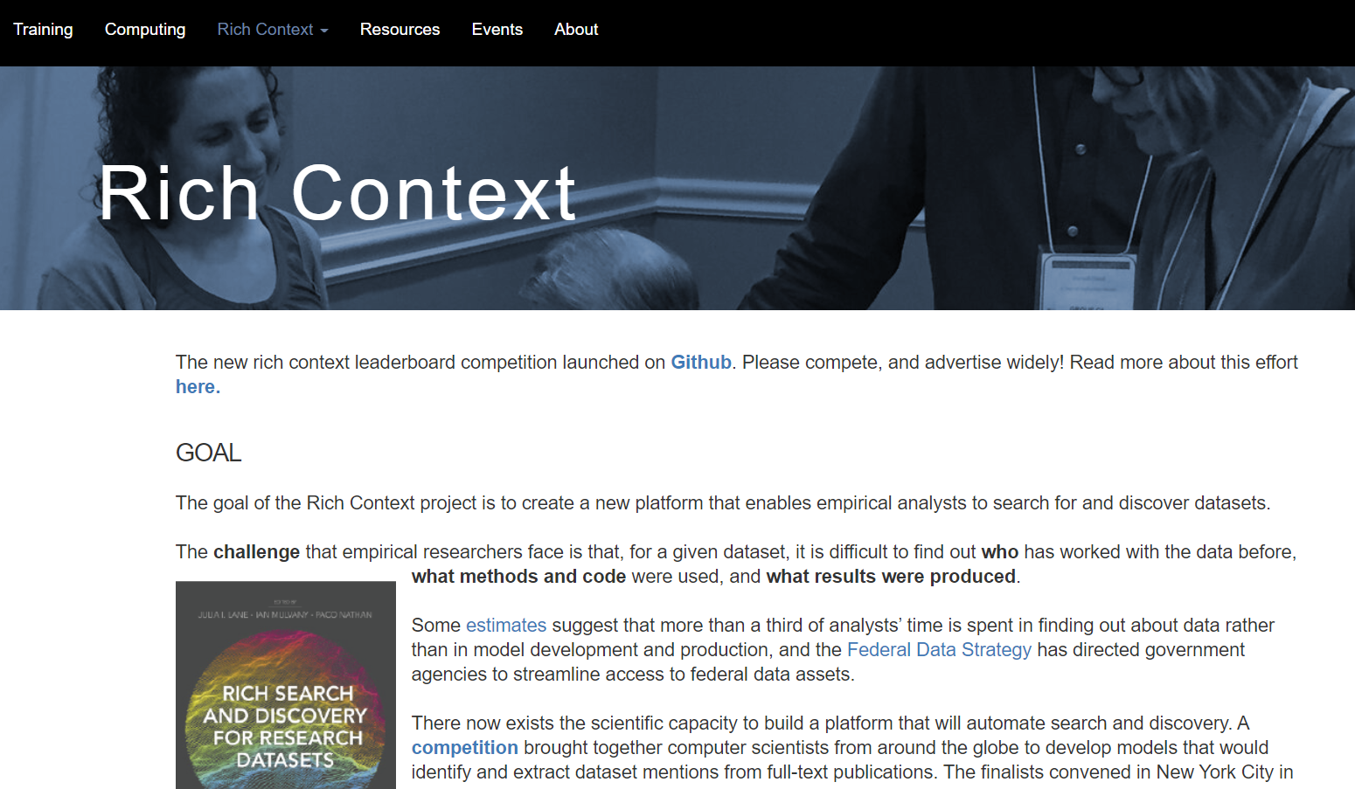
Leaderboard
Building on successes and learnings from the first Rich Context Competition, we’re moving to its next iteration.
This time we’re hosting a leaderboard competition patterned after the popular NLP-Progress and PapersWithCode SOTA.
Full details about the new competition are available at https://github.com/Coleridge-Initiative/rclc

Slide 32
Outline
Motivation
Definitions
Processing text data
Methods
Evaluation
Approaches and Applications

Slide 33
What is text?
A bunch of words
A bunch of linked words
A bunch of ambiguous linked words
A bunch of ambiguous linked words in multiple languages

Slide 34
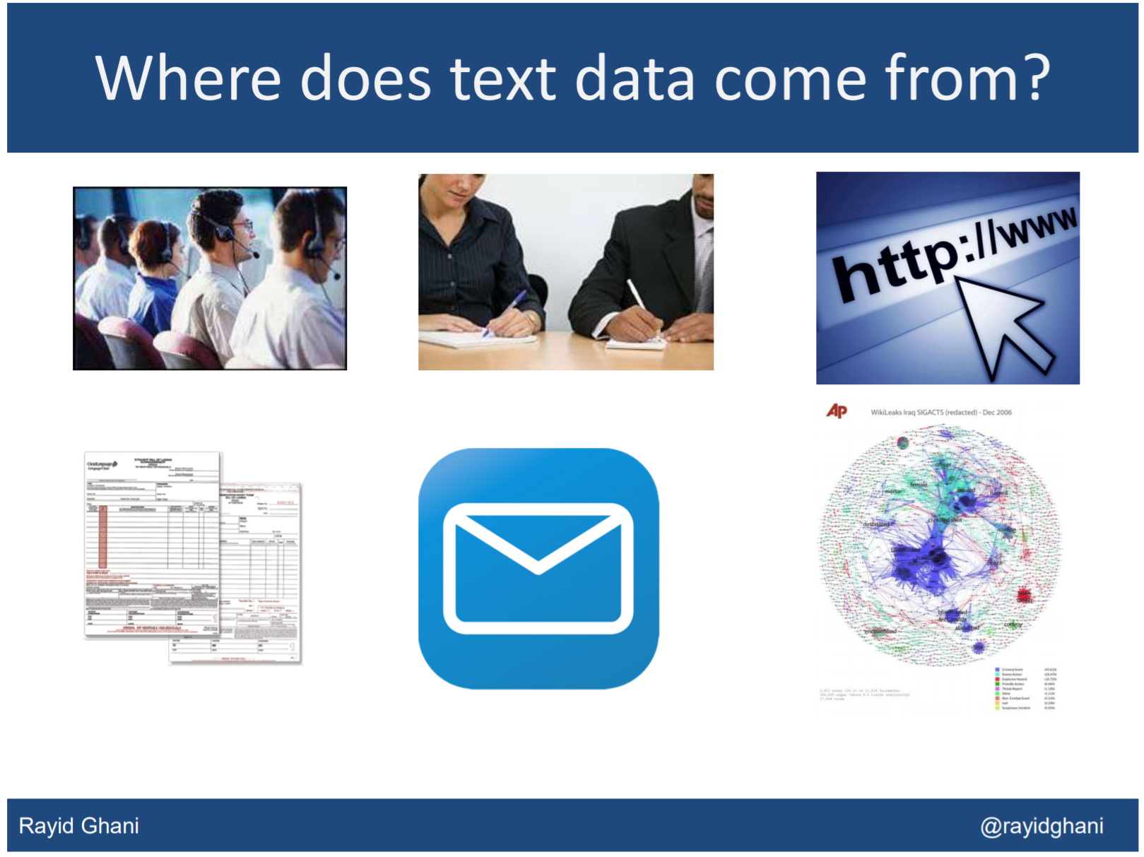

Slide 35
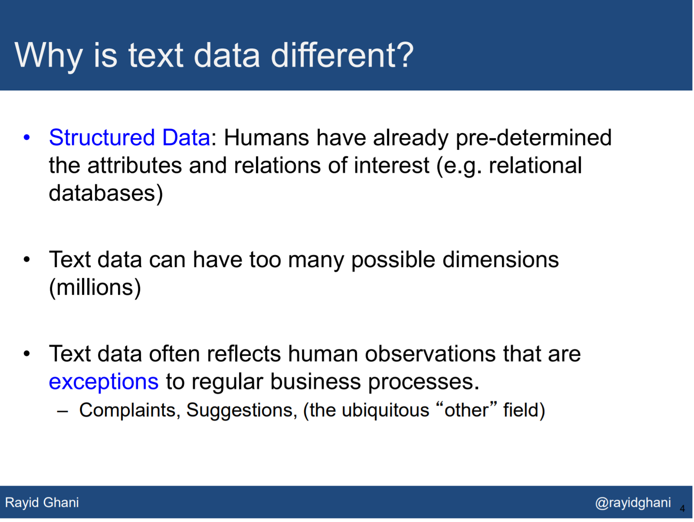

Slide 36
What is a document?
A purposefully organized text written in a given genre and style and serving a specific audience.

Slide 37
What is a corpus of documents?
A corpus is a collection of documents that are typically similar in purpose, genre and style and share similar statistical properties.

Slide 38
Text corpora: Examples
Brown University Standard Corpus of Present-Day American English (a.k.a. the Brown Corpus)
Lancaster-Oslo-Bergen Corpus
The Penn Treebank
TREC (NIST)
The Enron Corpus
NewsBank (News Database)

Slide 39
Varieties of Text
Language: English, Spanish, Chinese…
Genre: fiction, non-fiction…
Style: concise, longer sentences, many adjectives…
Purpose: policy document, scientific report, student essay…
Sentiment: positive, negative, neutral
Truth or lie
Target audience: electorate, funders, general public…

Slide 40
Varieties of text: Methods
Language: machine translation, PLTM
Genre and Style: word sense disambiguation
Purpose: document classification
Sentiment: sentiment analysis
Truth or lie: artificial intelligence
Target audience: topic modeling

Slide 41
Outline
Motivation
Definitions
Processing text data
Methods
Evaluation
Approaches and Applications

Slide 42
Text Analytics: Classification Pipeline
Input Data
Category 1
Document 1
Document 2
Category 2
Document 1
Document 2
Category …
Document
Document
Document …
Segmentation
Stop Word Removal
Stemming
Tokenization
Paragraph Extraction
Background lexicons
Part of Speech Tagging
Phrase (n-gram) extraction
Feature Selection
Negation Handling
Feature Weighting
Feature Scaling
Sentence Extraction
Pre-Processing
Classification Algorithms
Naïve Bayes
SVM
…
Classification Models

Slide 43
Statistical properties of text
Length (of sentences, of documents, of corpora)
Term frequency
Document frequency
Term co-occurrence

Slide 44
Tokenization
Process of separating sentences and words from each other by syntax
Different types of tokenizers: the simplest is by splitting at common punctuation
BUT: a quote can be part of the same sentence; a dash can be part of same word or separate two parts of the same sentence; data quality can be low

Slide 45
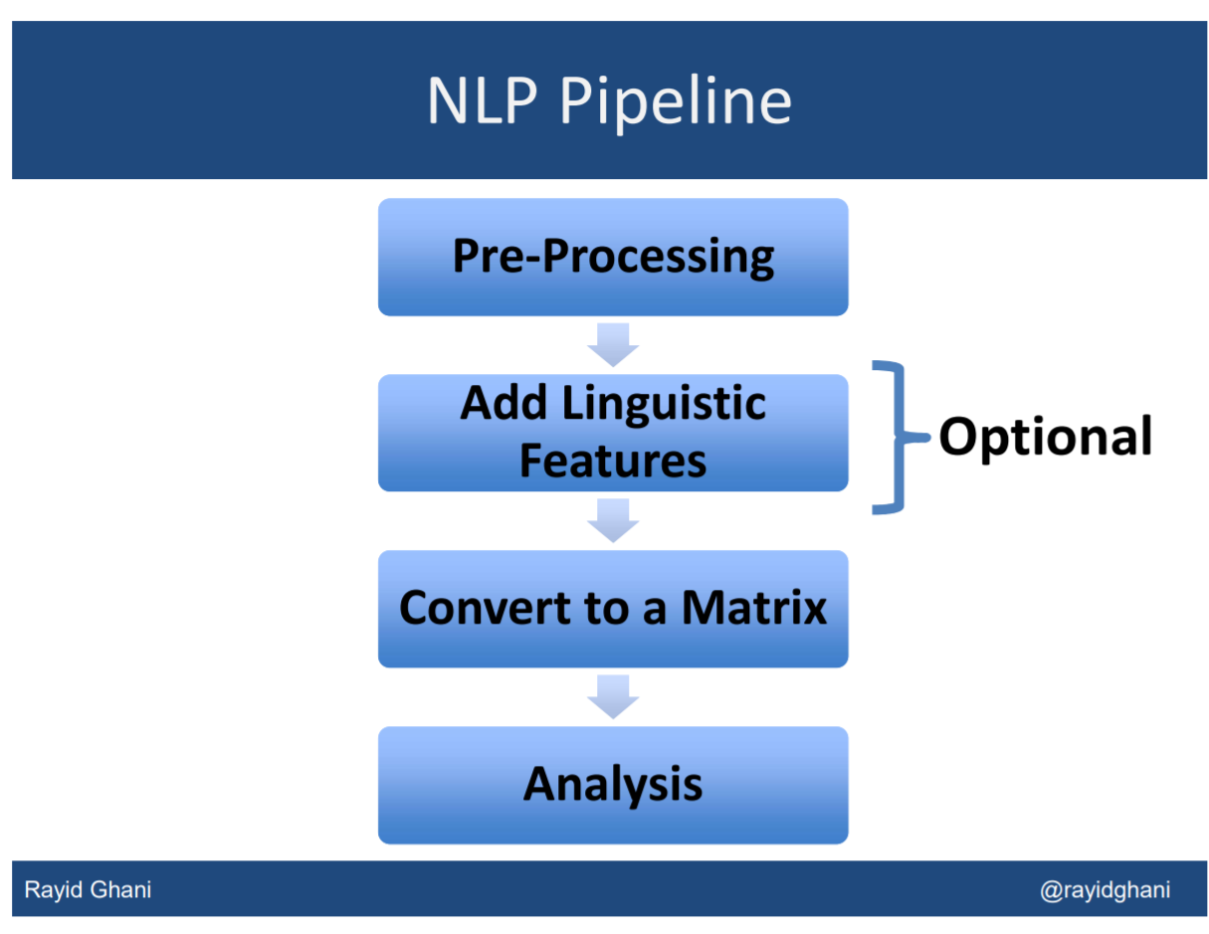

Slide 46
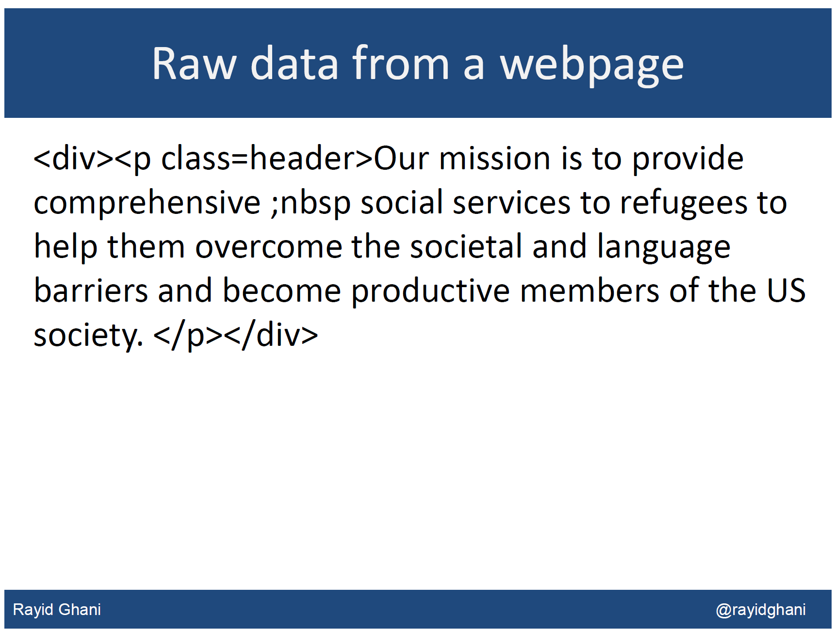

Slide 47
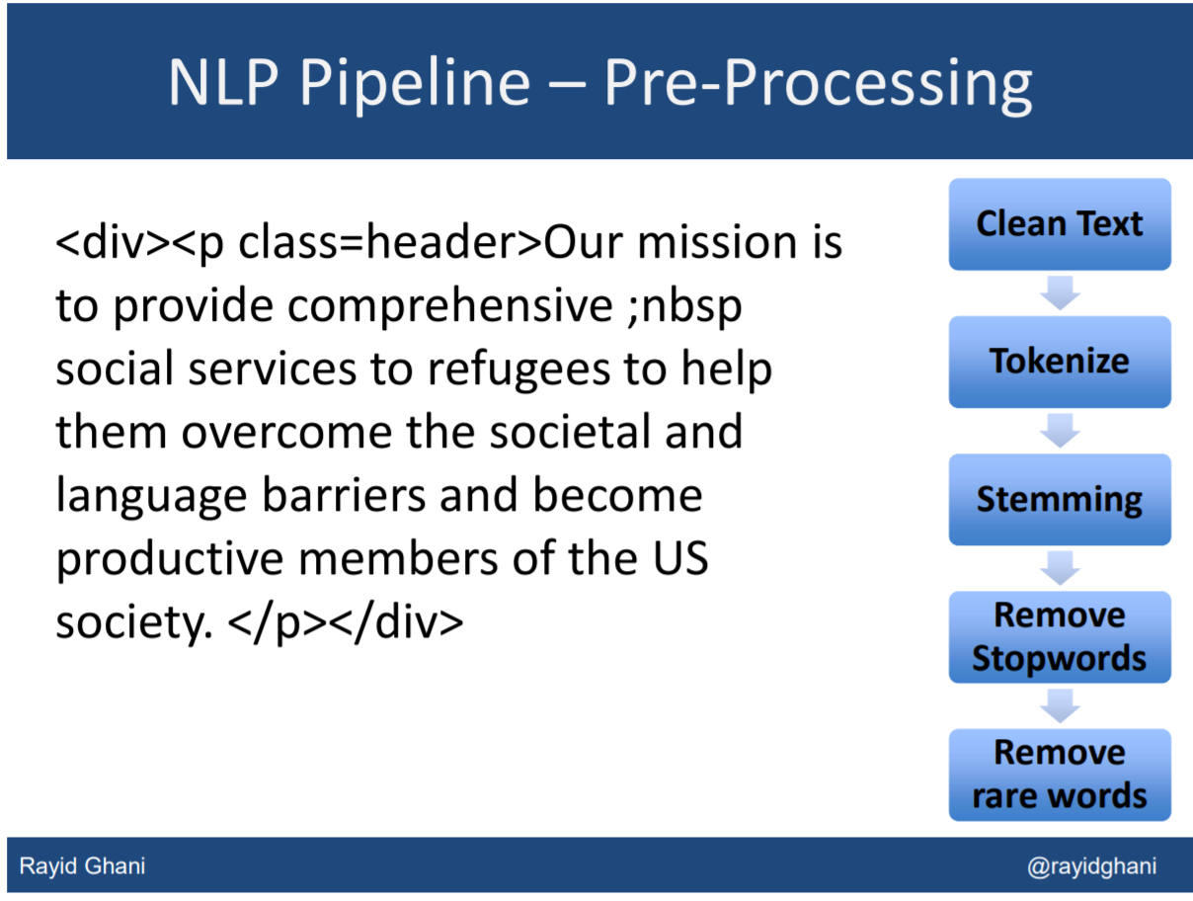

Slide 48
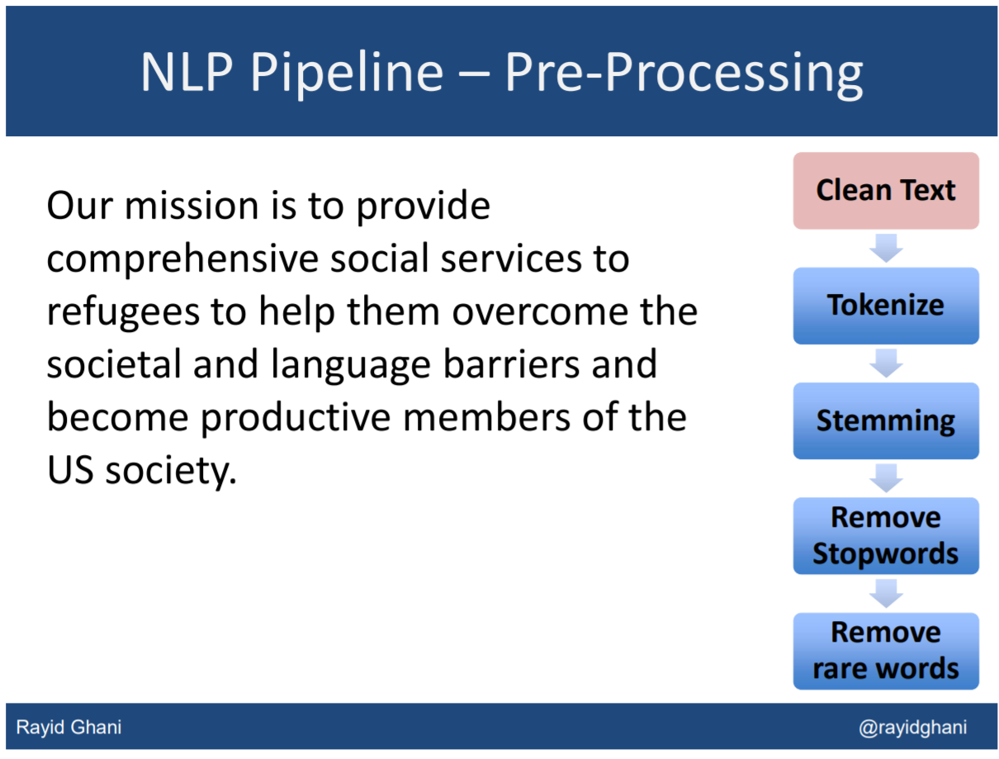

Slide 49
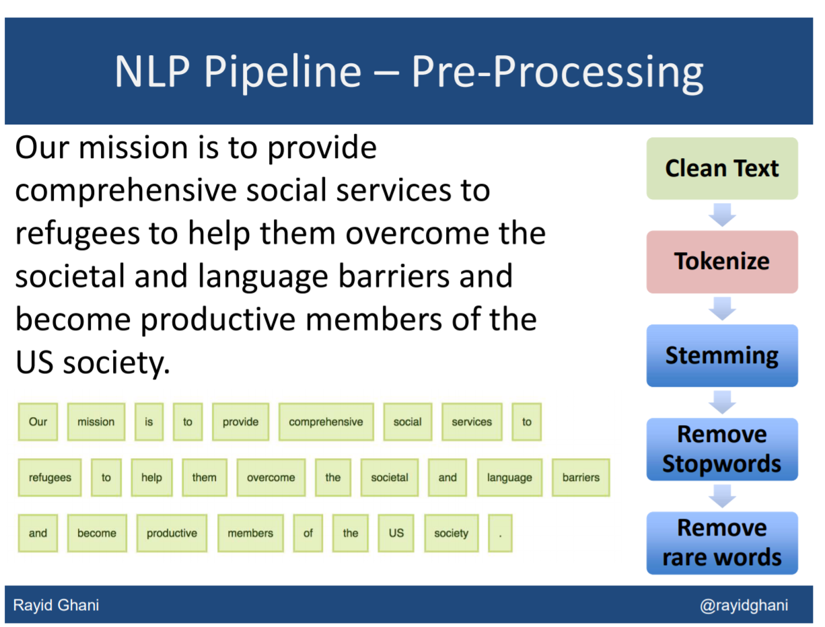

Slide 50
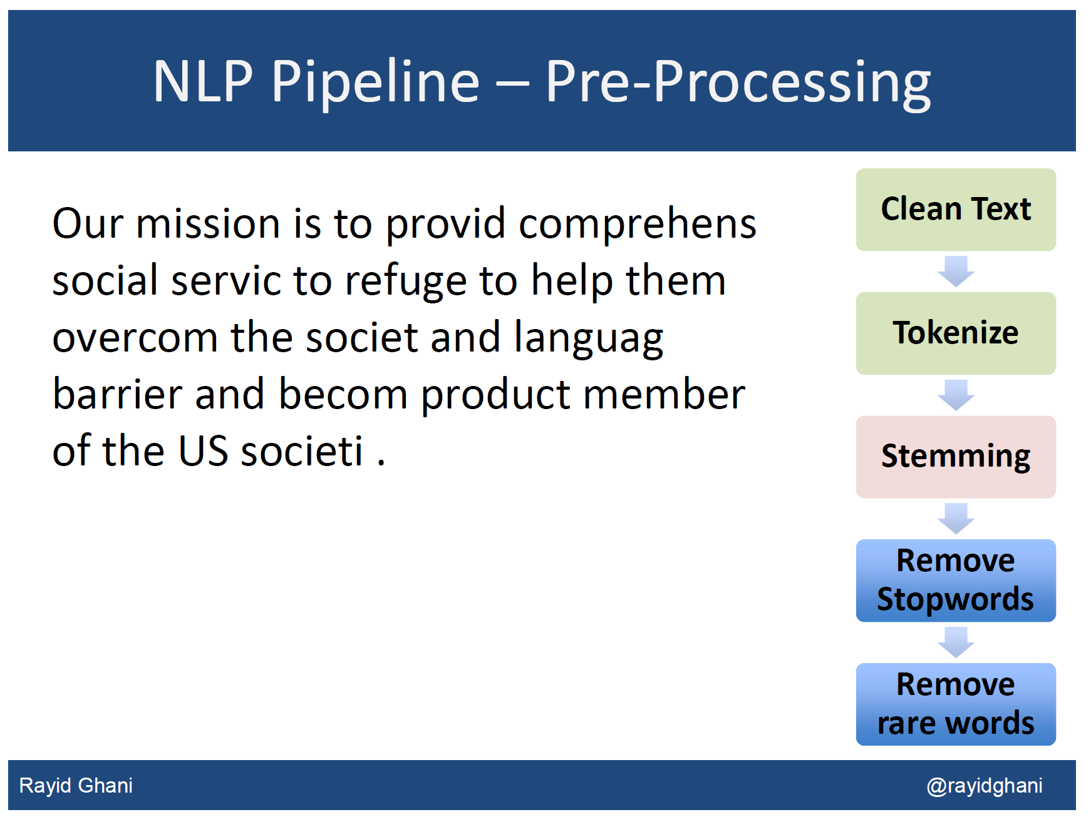

Slide 51


Slide 52
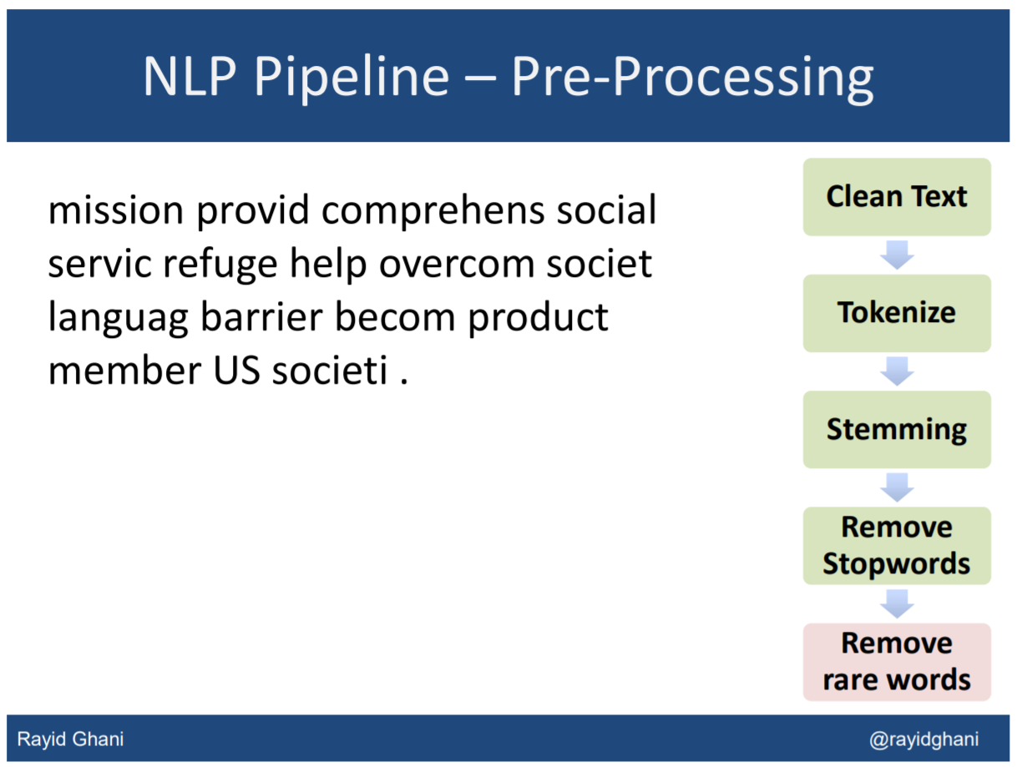

Slide 53
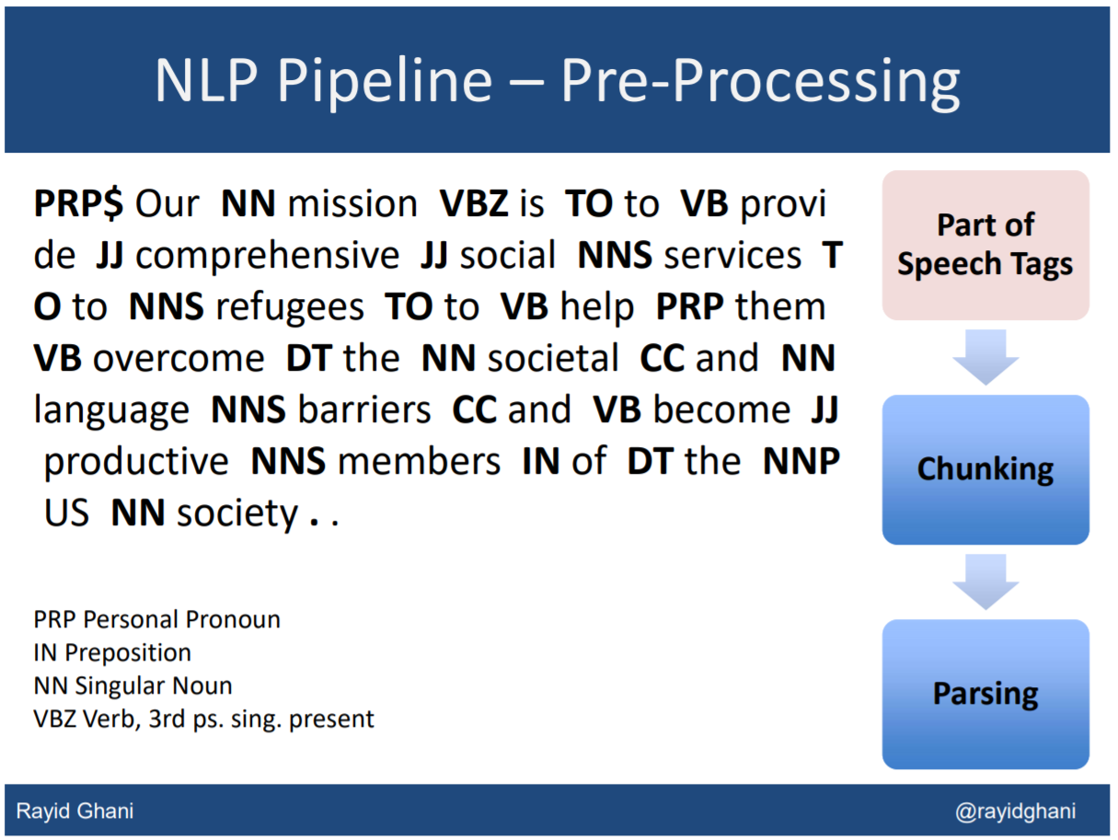

Slide 54
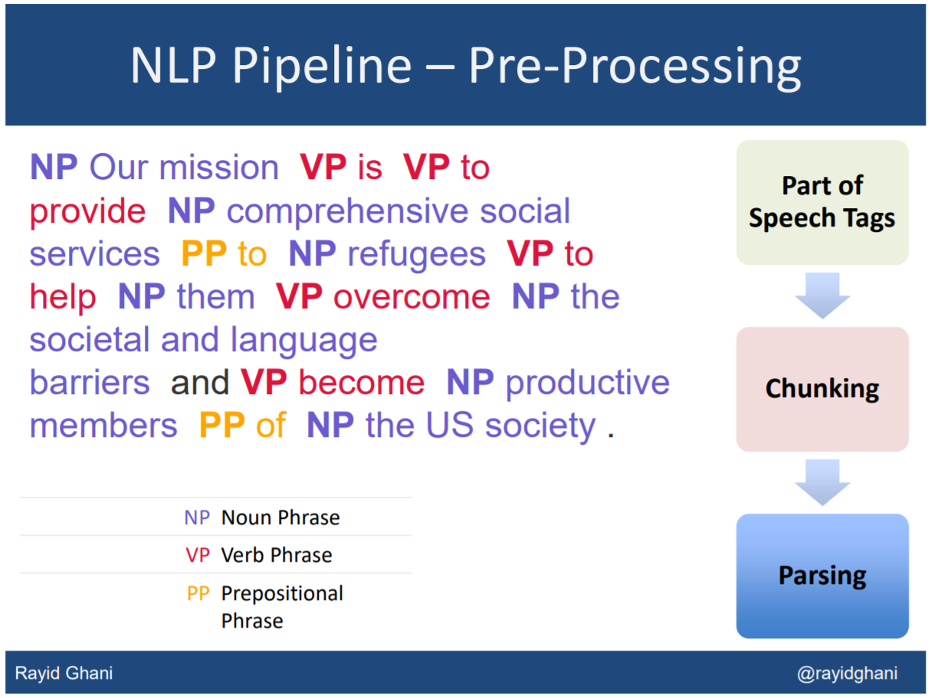

Slide 55
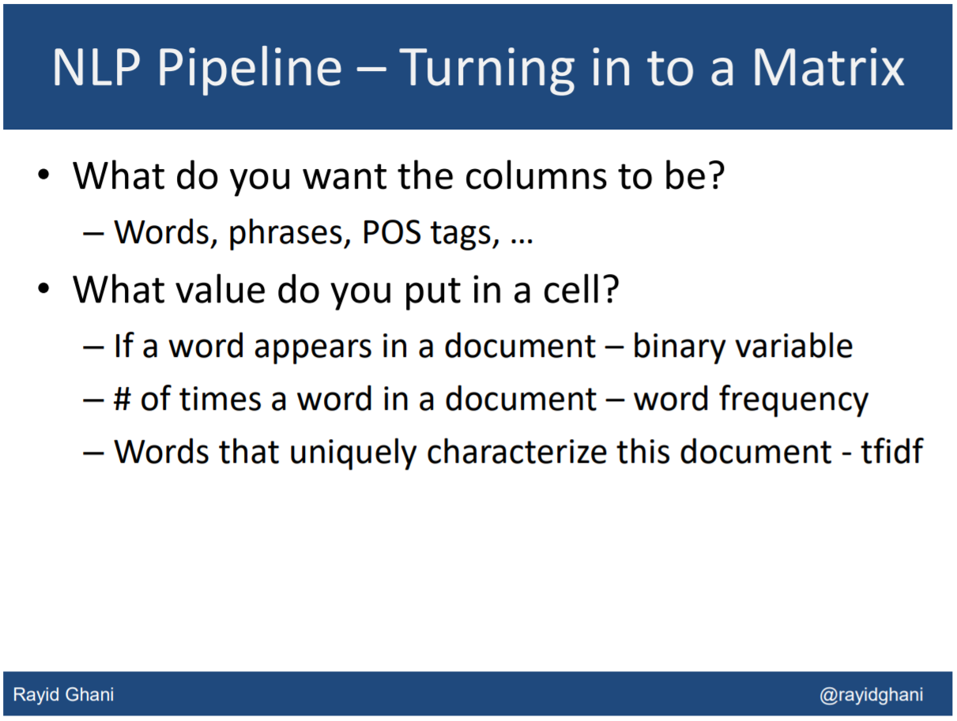

Slide 56
Text as a ‘bag-of-words’
Vector space representation of text – every word has its unique id (e.g., ‘comprehensive’=0, ‘social’=1, ‘language’=2, ‘members’=3, etc.) and the number of occurrences within the document:
# of instances
Our mission is to provide comprehensive social services to refugees to help them overcome the societal and language barriers and become productive members of the US society.
word IDs

Slide 57
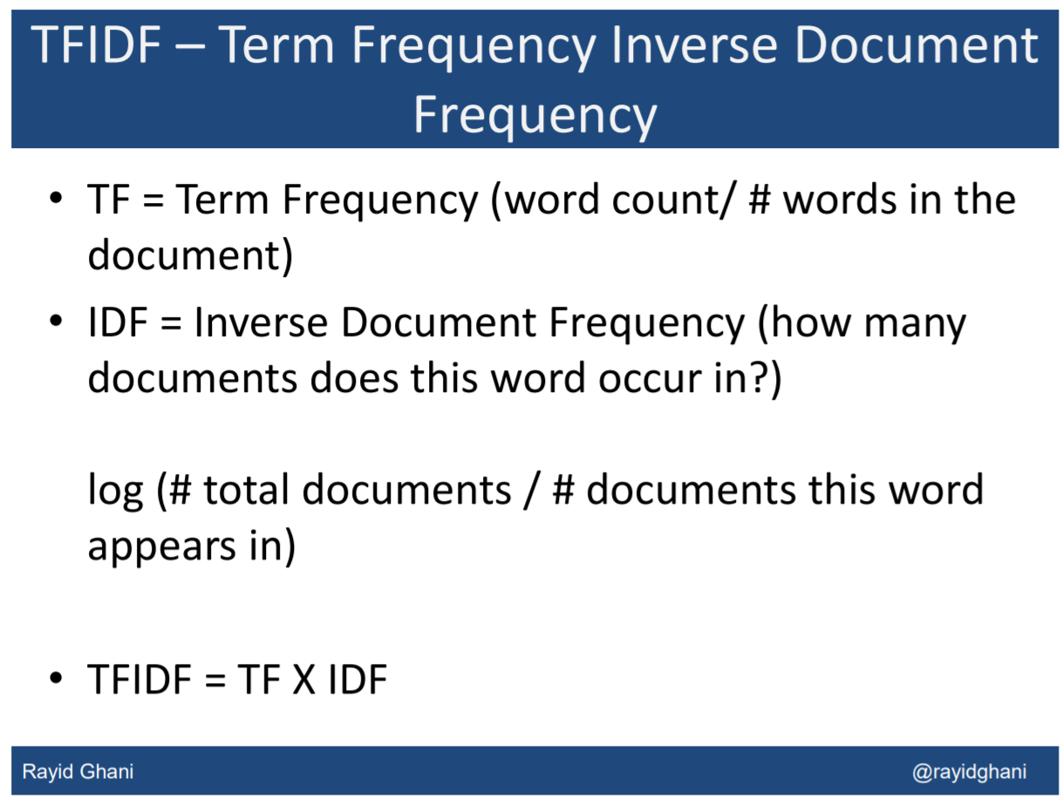

Slide 58
Processing text data: summary
GIGO (Garbage In Garbage Out) – proper data processing is critical for the outcome
Techniques differ dependent on the corpus properties and applications (what do we want to learn?)
NLTK (Natural Language Toolkit in Python) and other software packages have good tools for processing text data

Slide 59
Outline
Motivation
Definitions
Processing text data
Methods
Evaluation
Approaches and Applications

Slide 60
Methods: Natural Language Processing
NLP can be used to identify
Parts of speech (Noun, Verb)
Tokens of related words (San and Francisco probably combined to San Francisco)
Find the probability of words appearing in a corpus of text.
Identify sentiment.
Two approaches:
Word Vectorization
Doc2vec modelling
Notes:
Note: We stem and lemmatize the words to find common phrases, as well as removing stop words

Slide 61
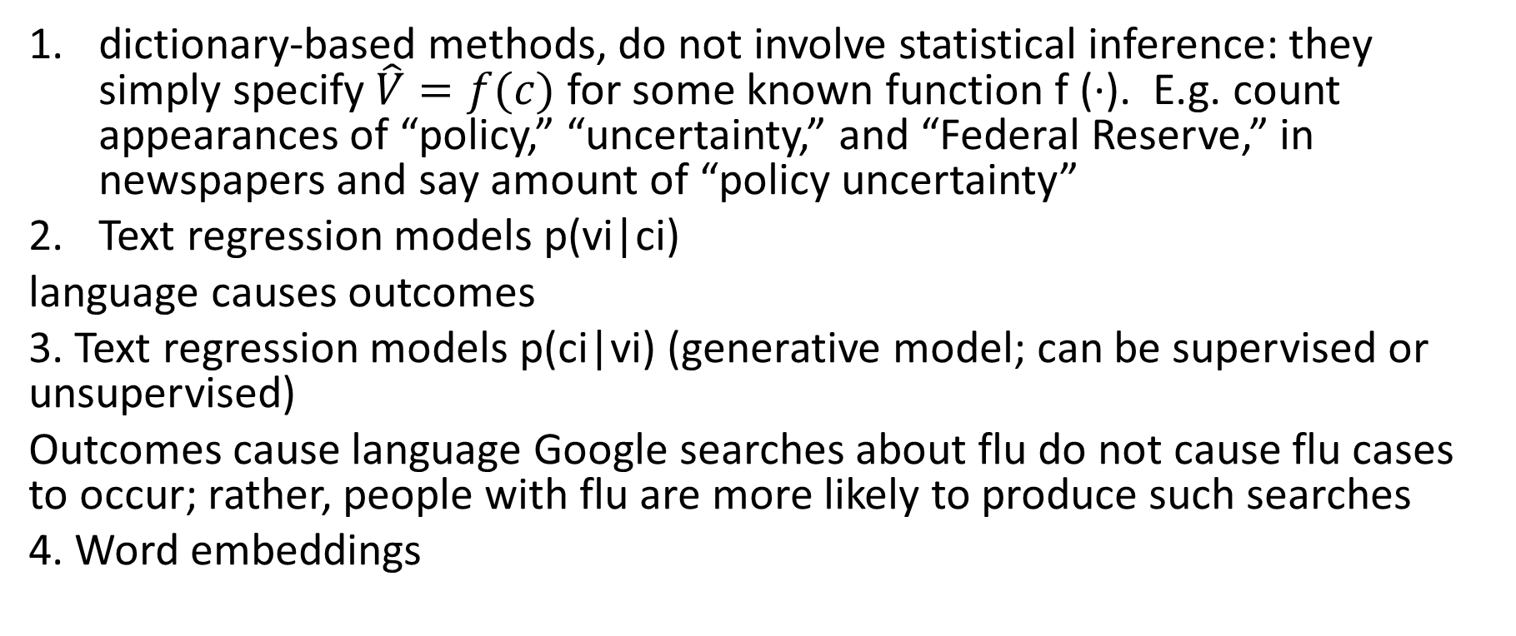
Four different types of models
dictionary-based methods, do not involve statistical inference: they simply specify $\hat{V}=f(c)$ for some known function f (·). E.g. count appearances of “policy,” “uncertainty,” and “Federal Reserve,” in newspapers and say amount of “policy uncertainty”
Text regression models p(vi|ci)
language causes outcomes
3. Text regression models p(ci|vi) (generative model; can be supervised or unsupervised)
Outcomes cause language Google searches about flu do not cause flu cases to occur; rather, people with flu are more likely to produce such searches
4. Word embeddings

Slide 62
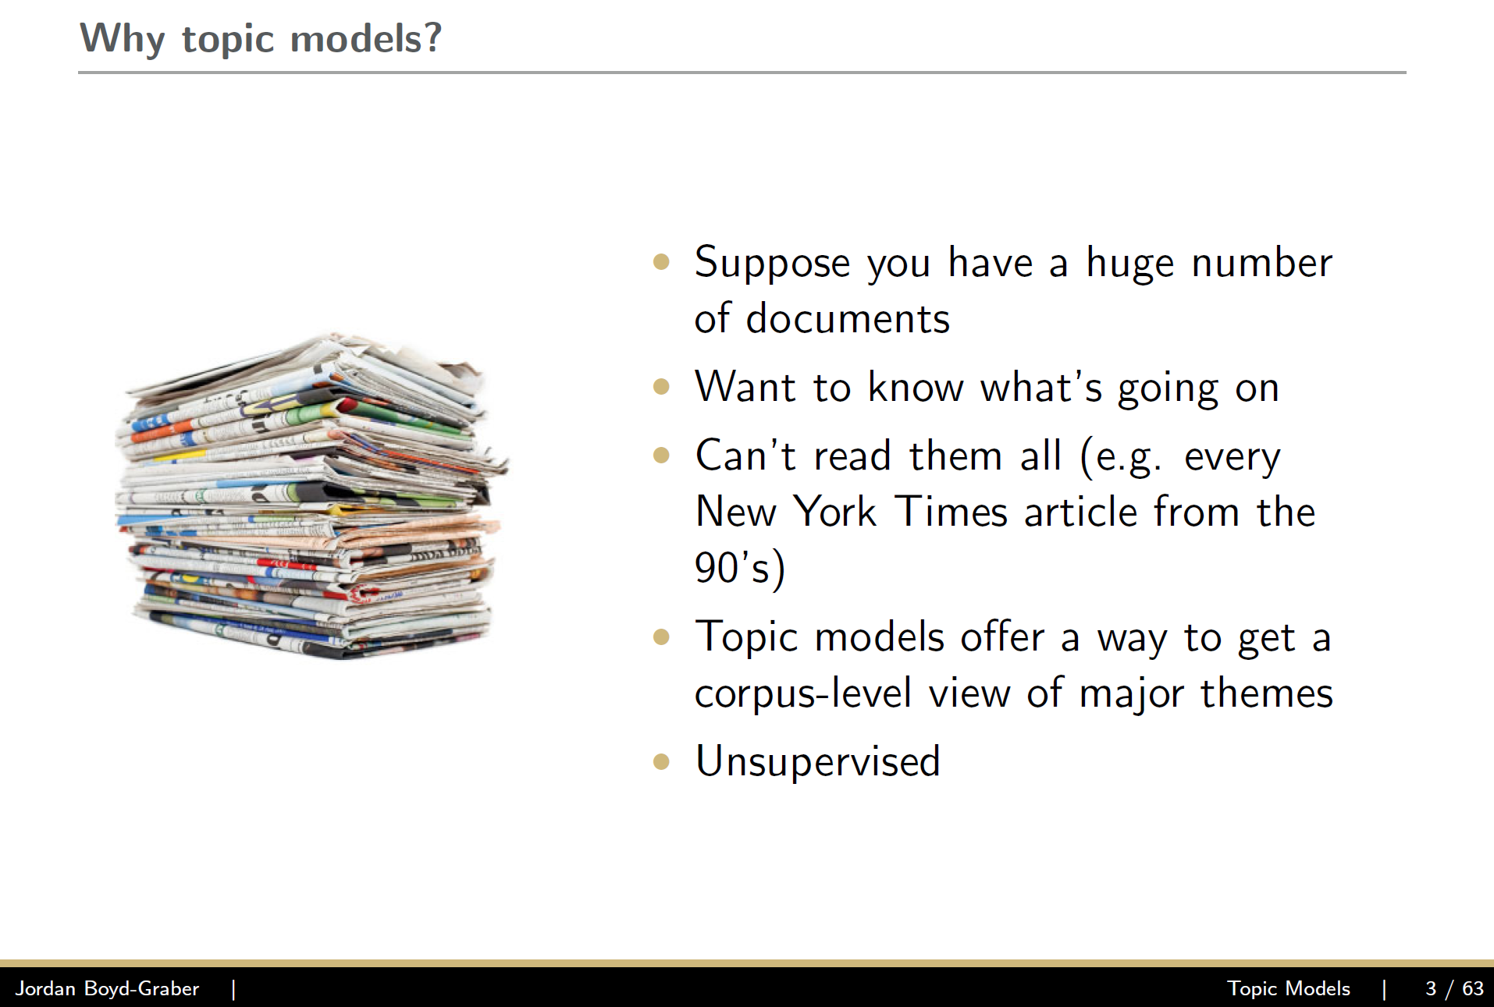
Example – topic models (unsupervised generative model - see Blei)

Slide 63
Topic Models
Approach – latent variables
Topics to words
Documents to topics
Model: story of how your data came to be
Latent variables: missing pieces of your story
Statistical inference: ﬁlling in those missing pieces
Jordan Boyd Graber

Slide 64
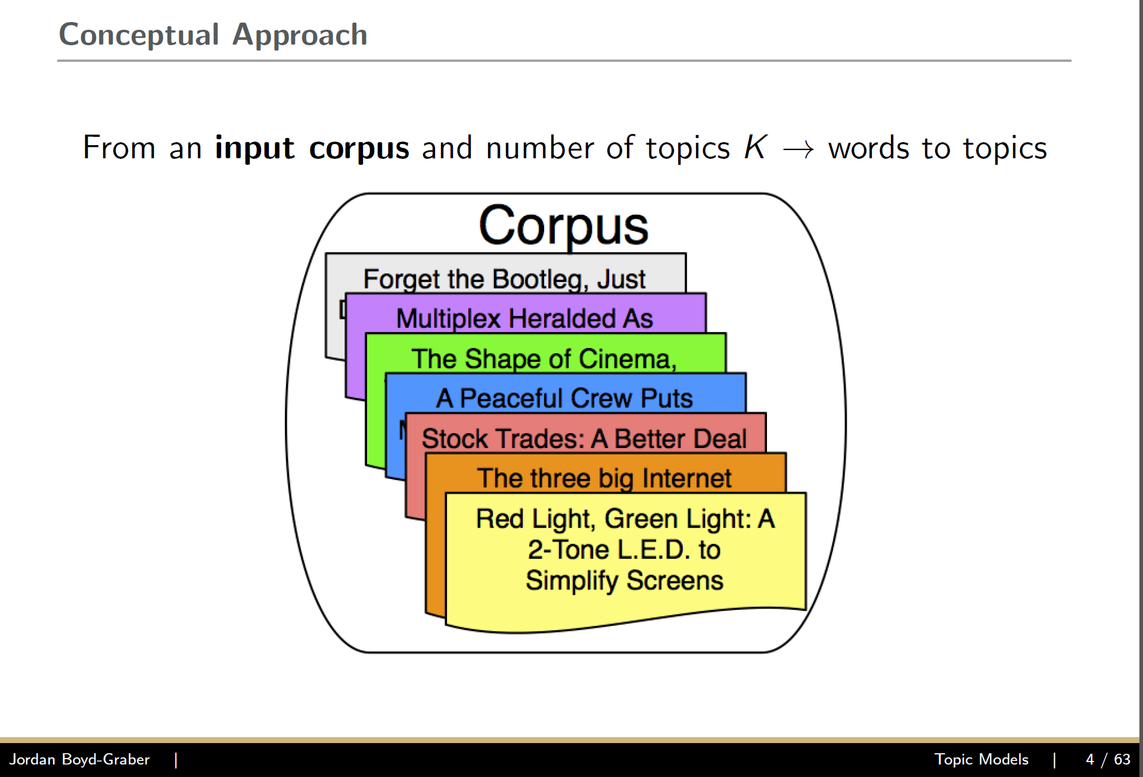

Slide 65
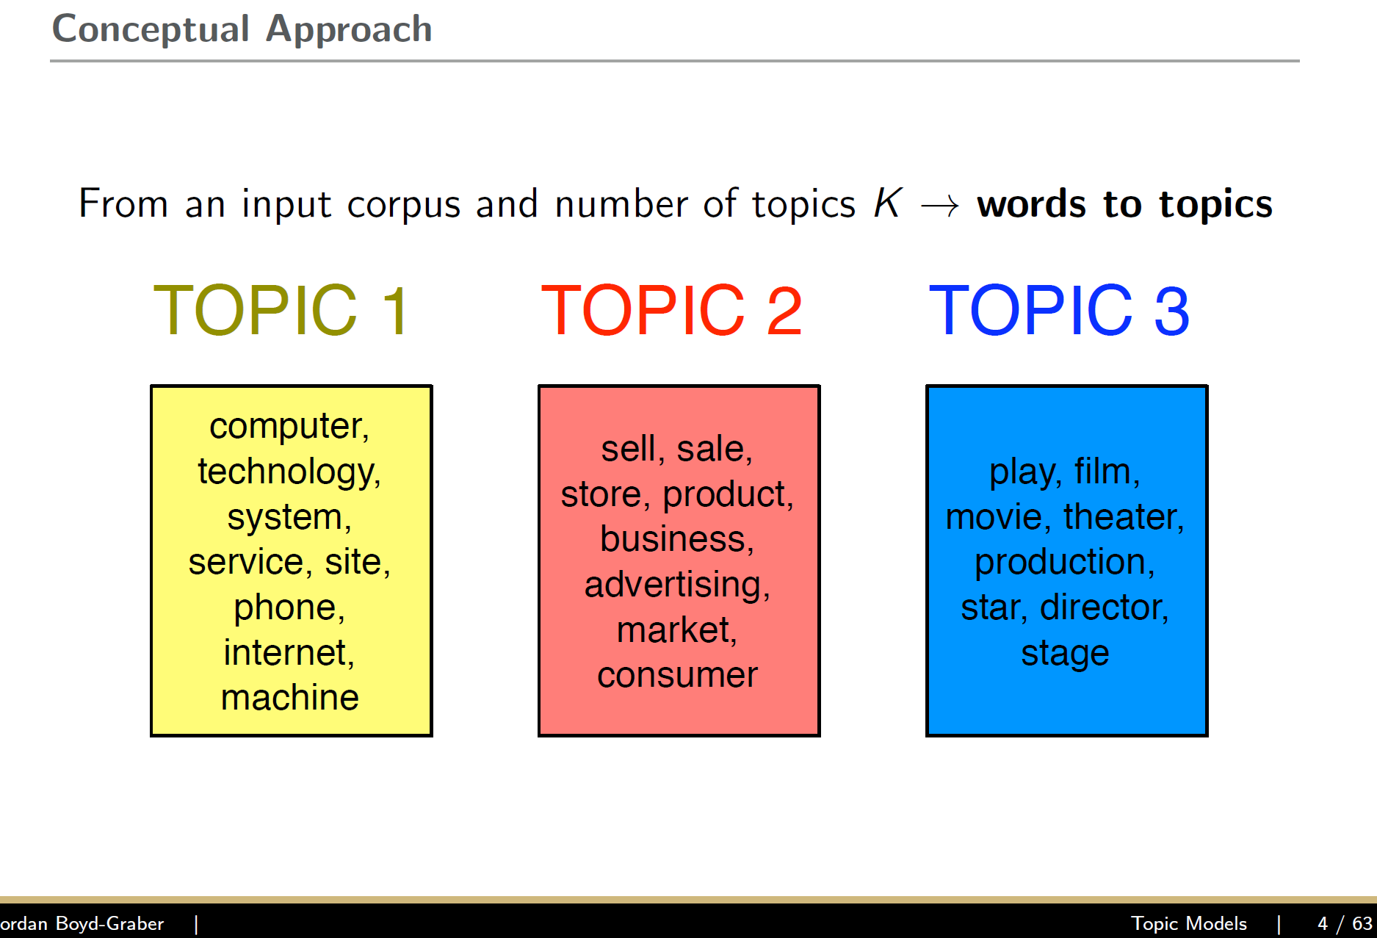

Slide 66
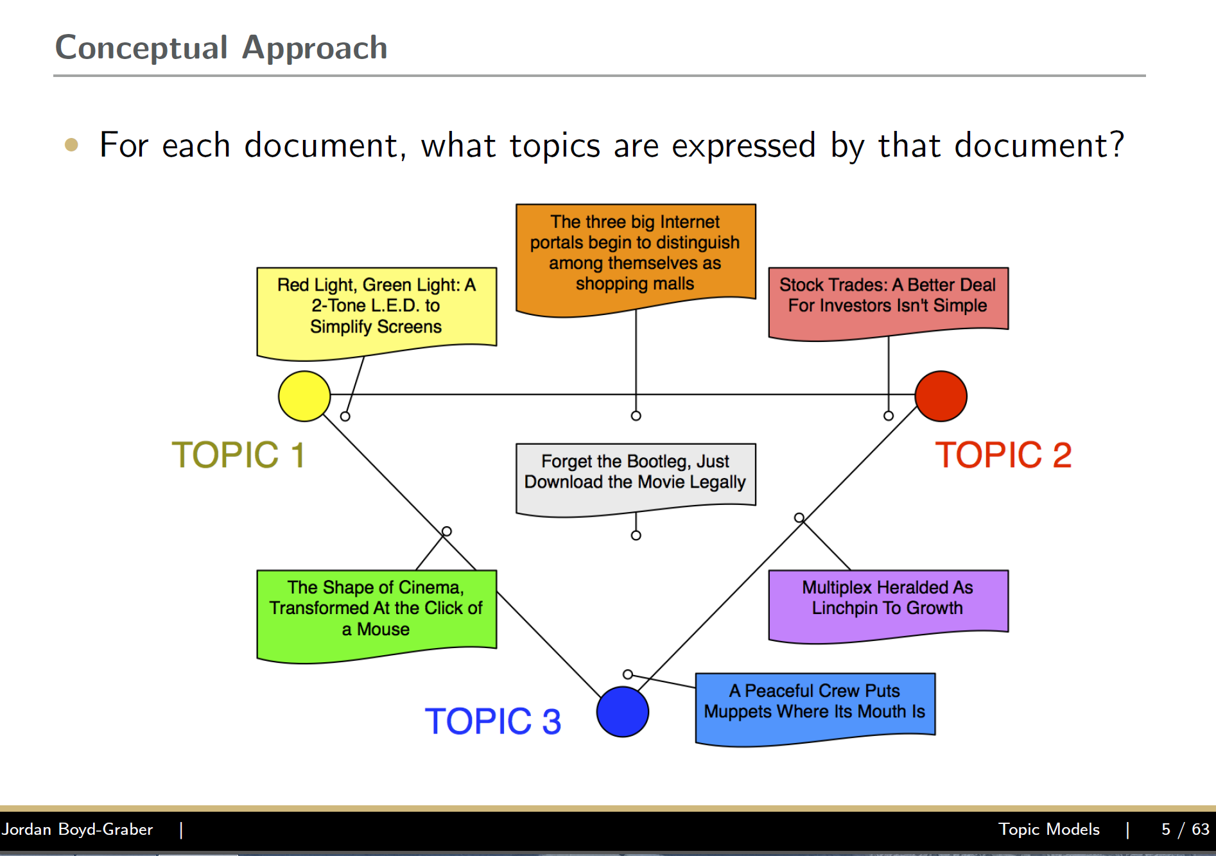

Slide 67
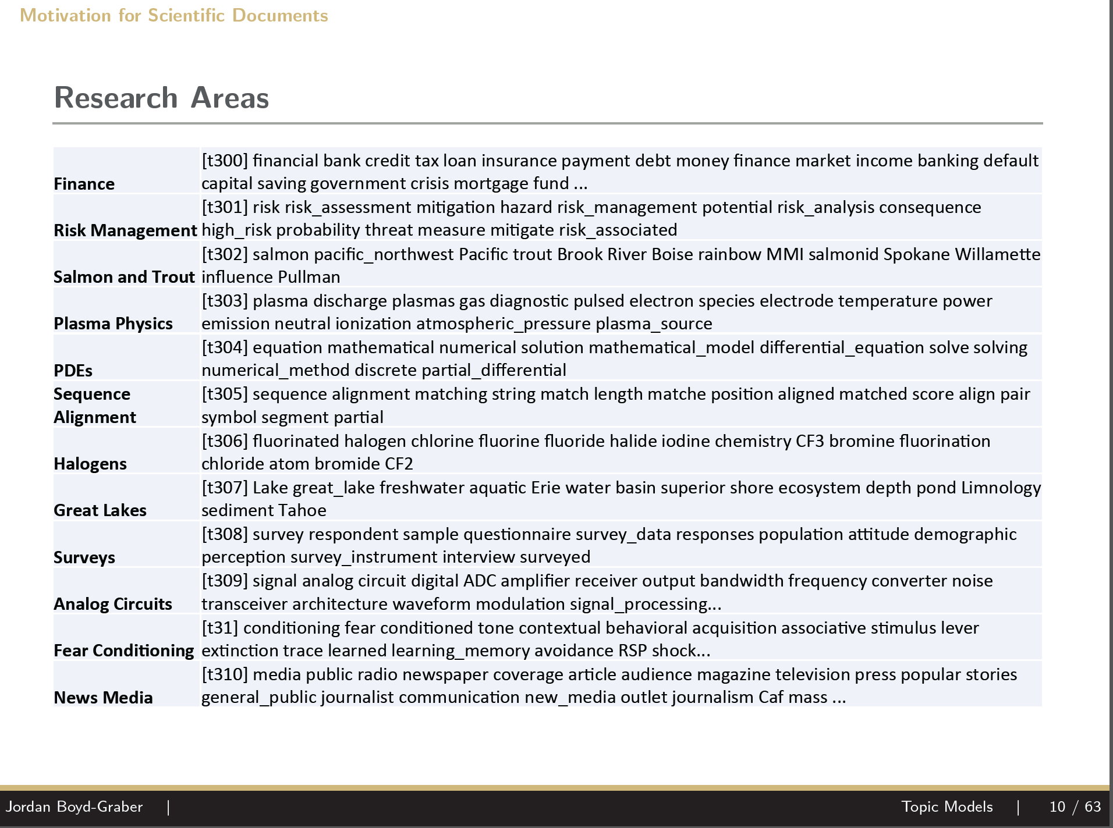

Slide 68
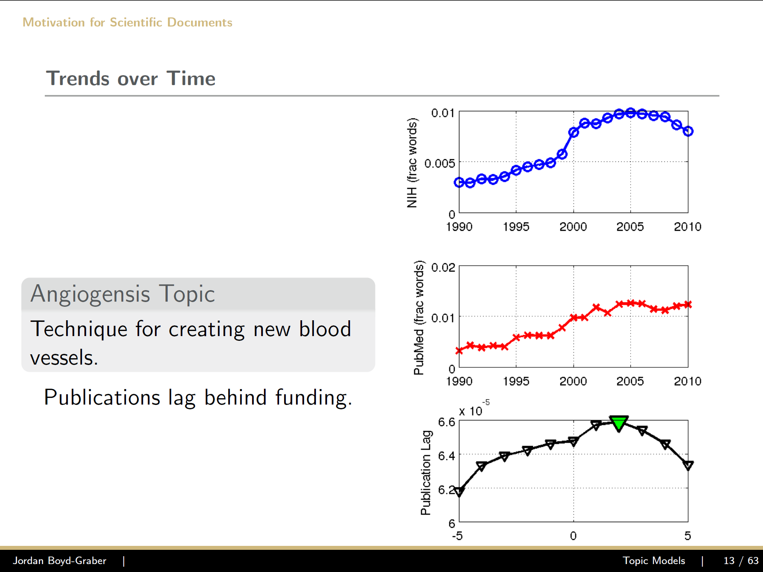

Slide 69
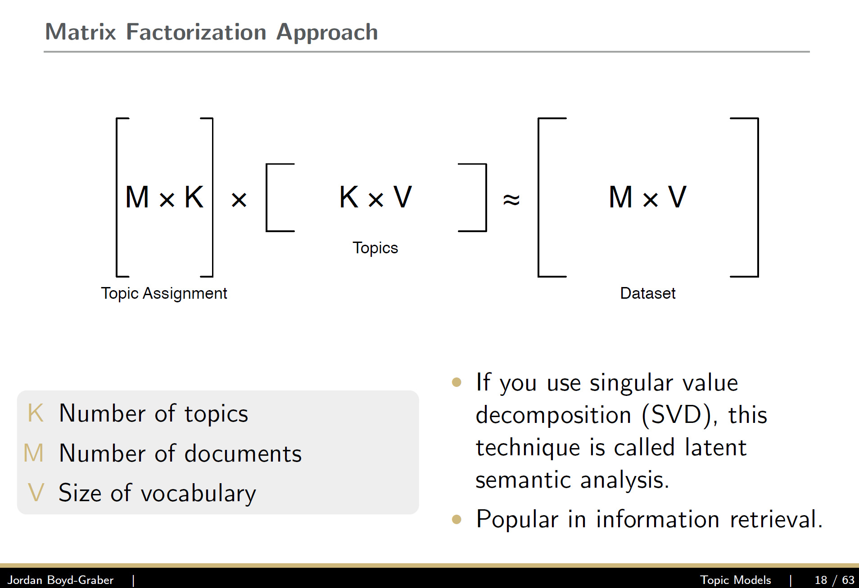

Slide 70
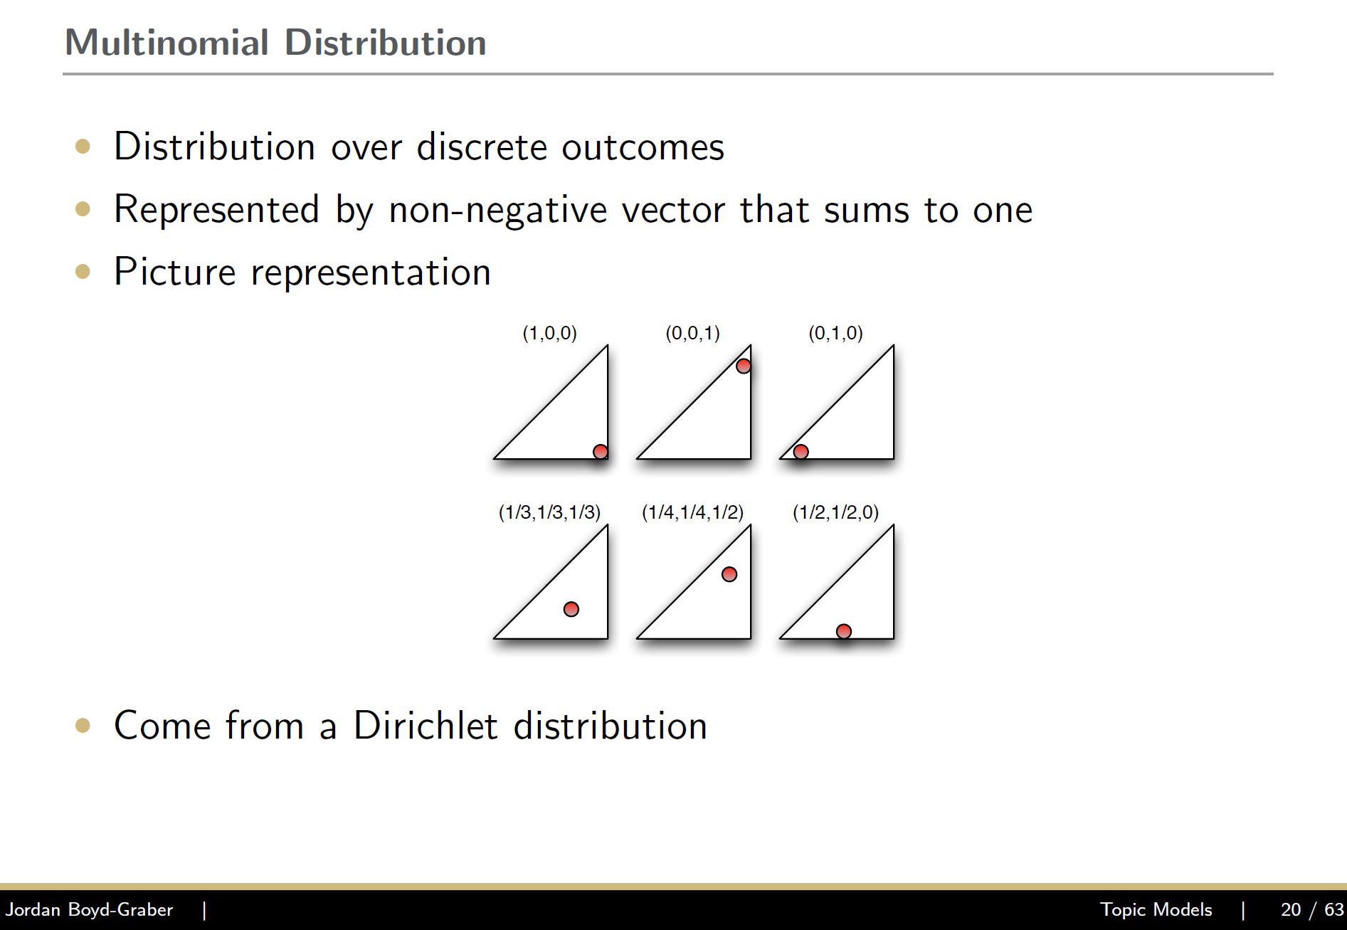

Slide 71
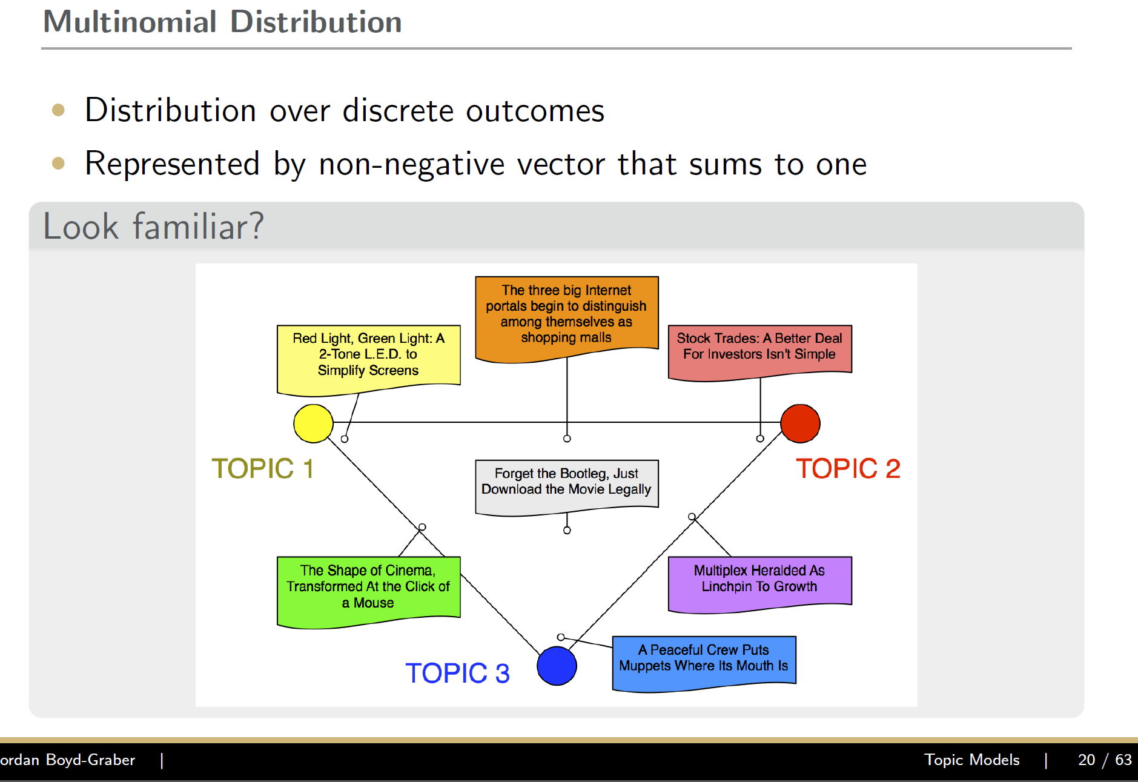

Slide 72
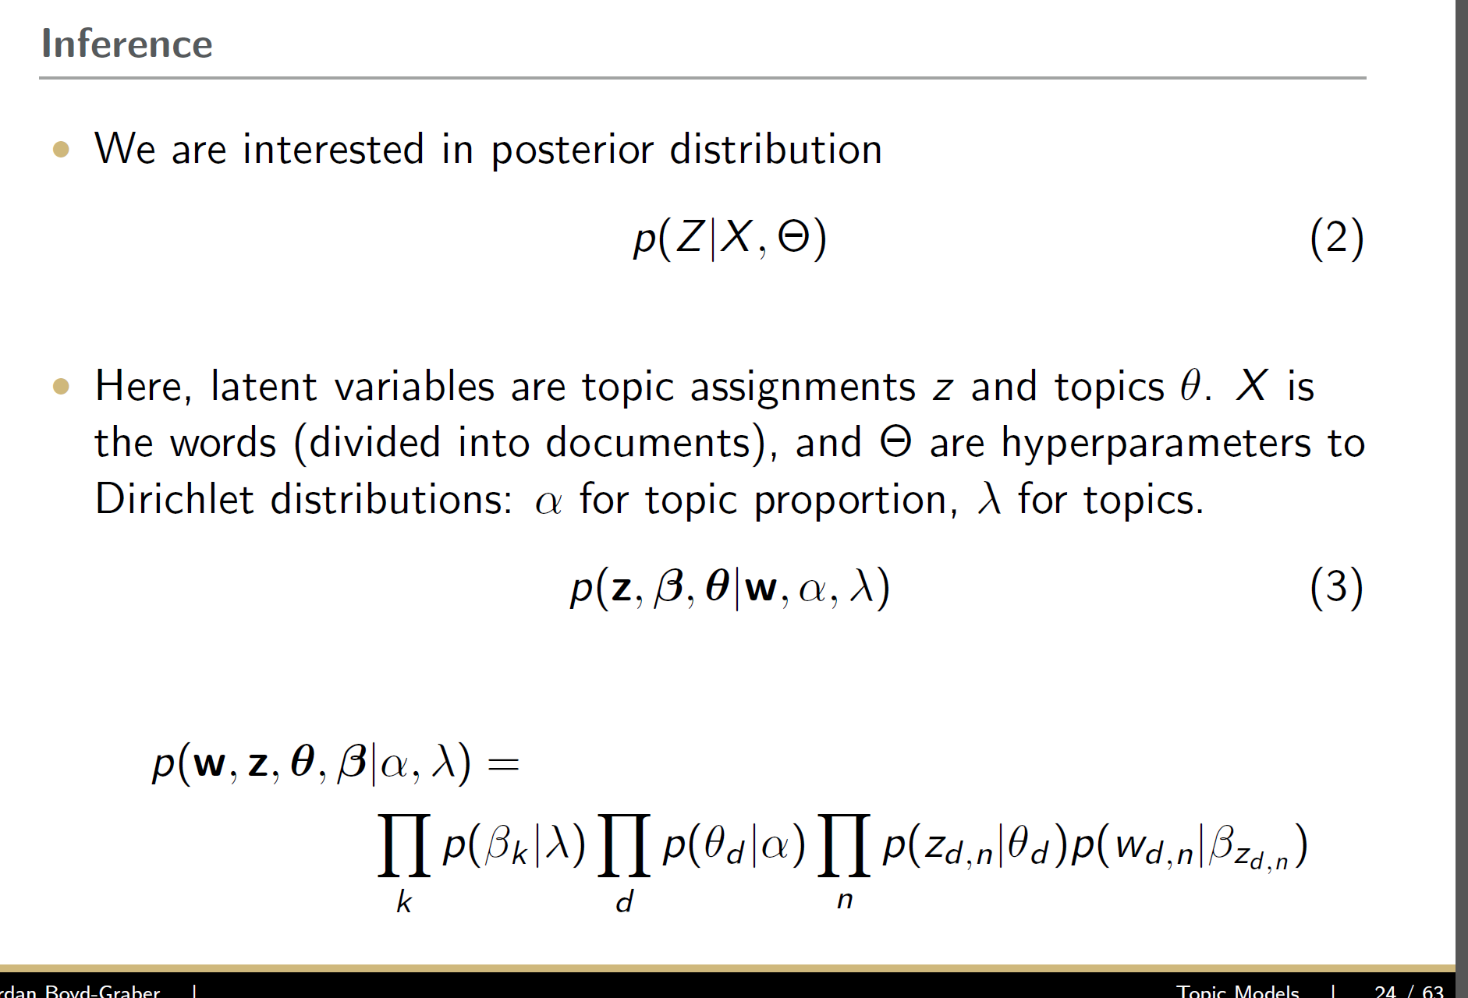

Slide 73
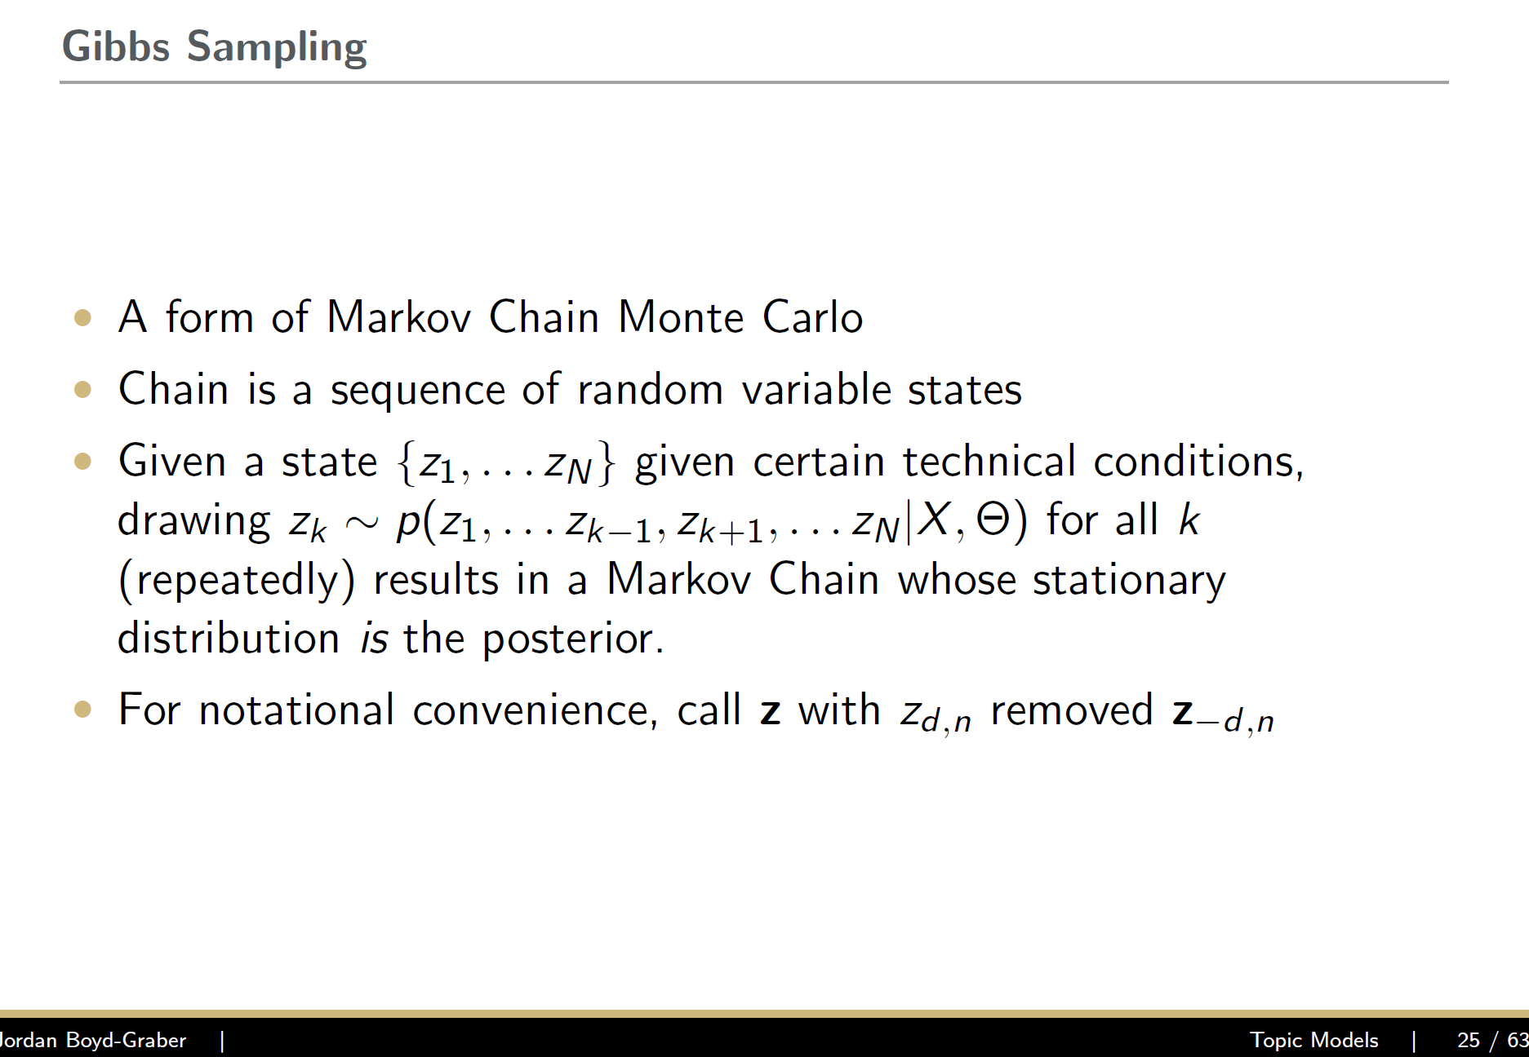

Slide 74
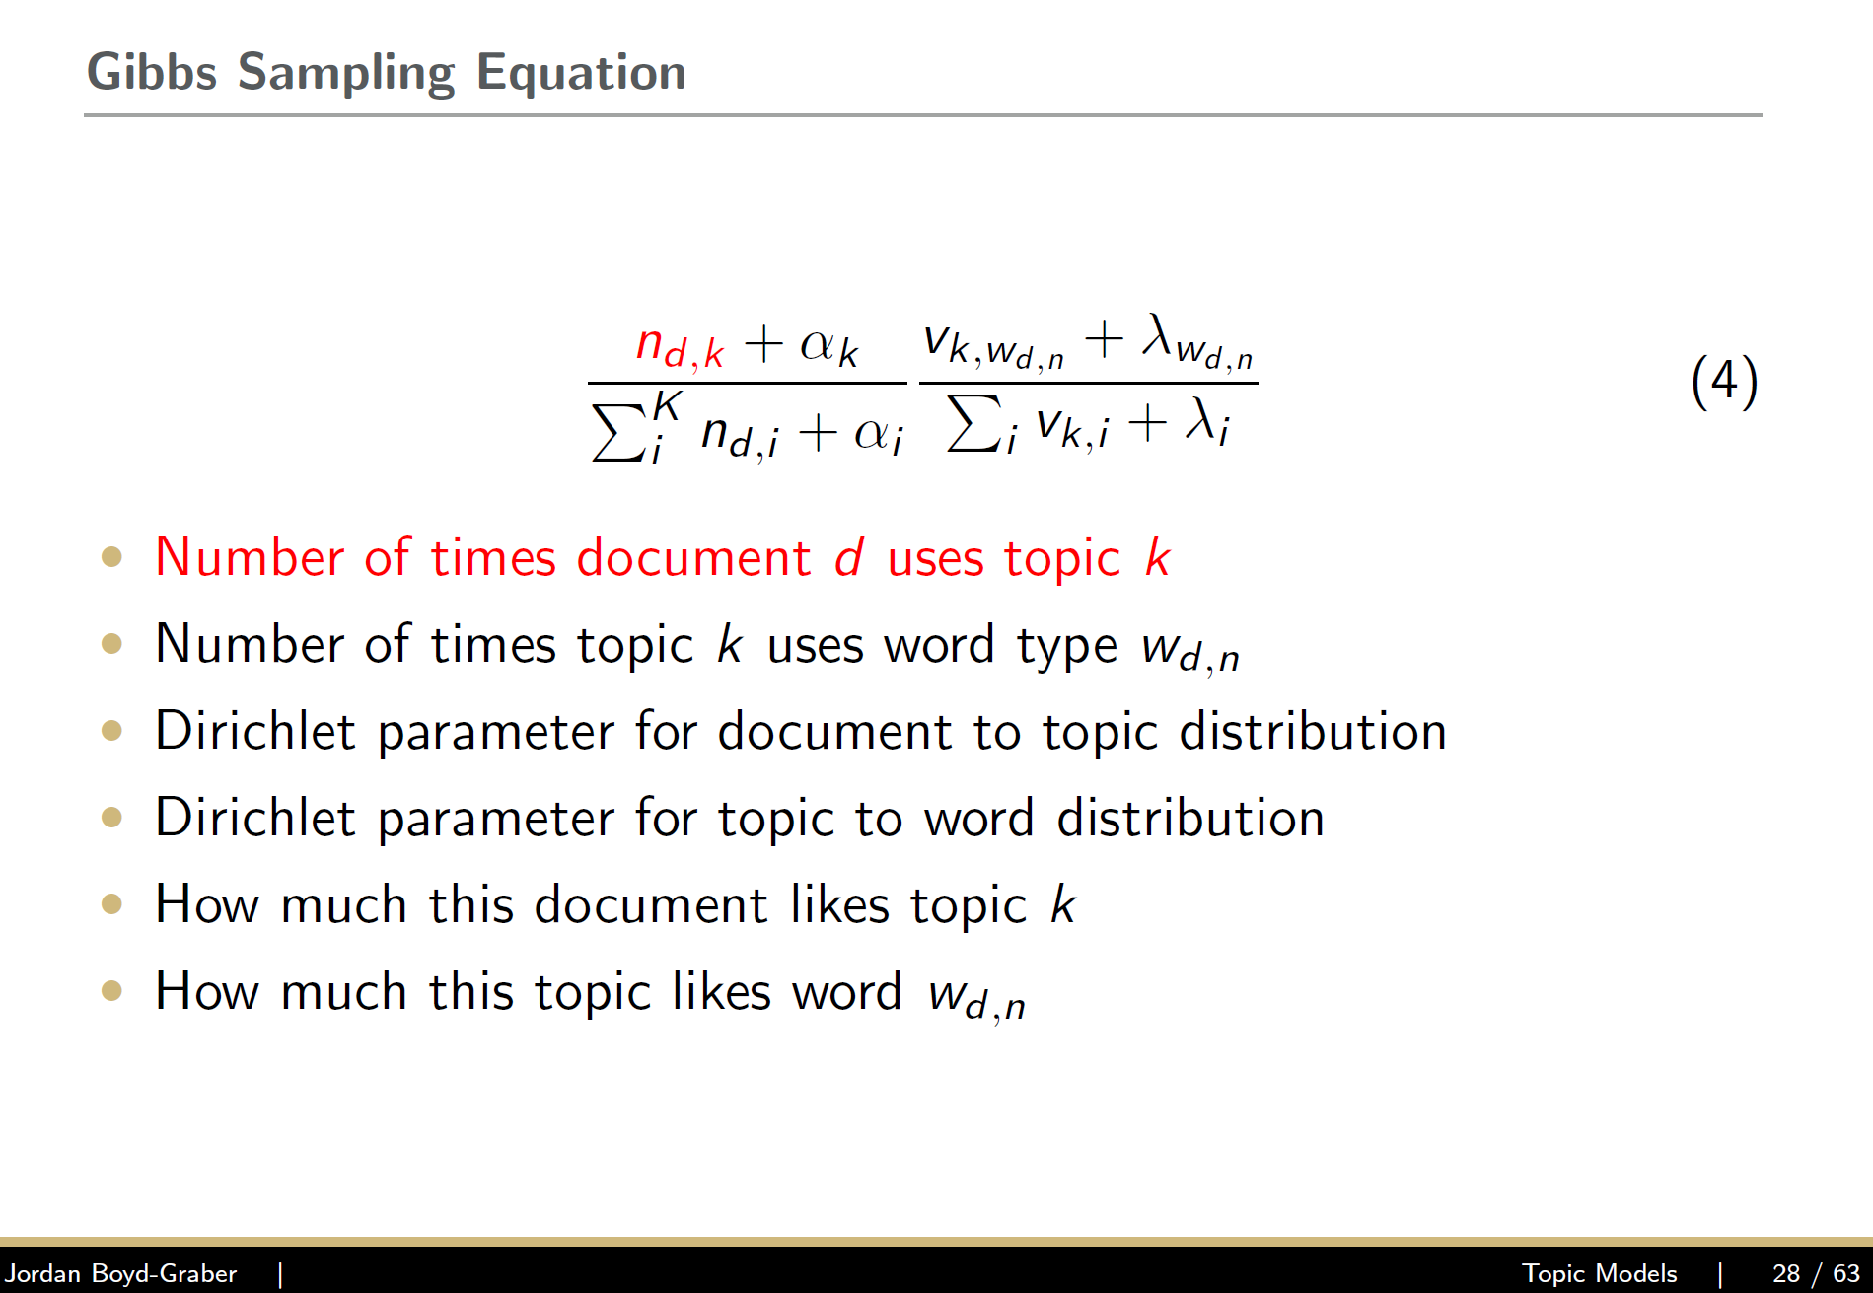

Slide 75
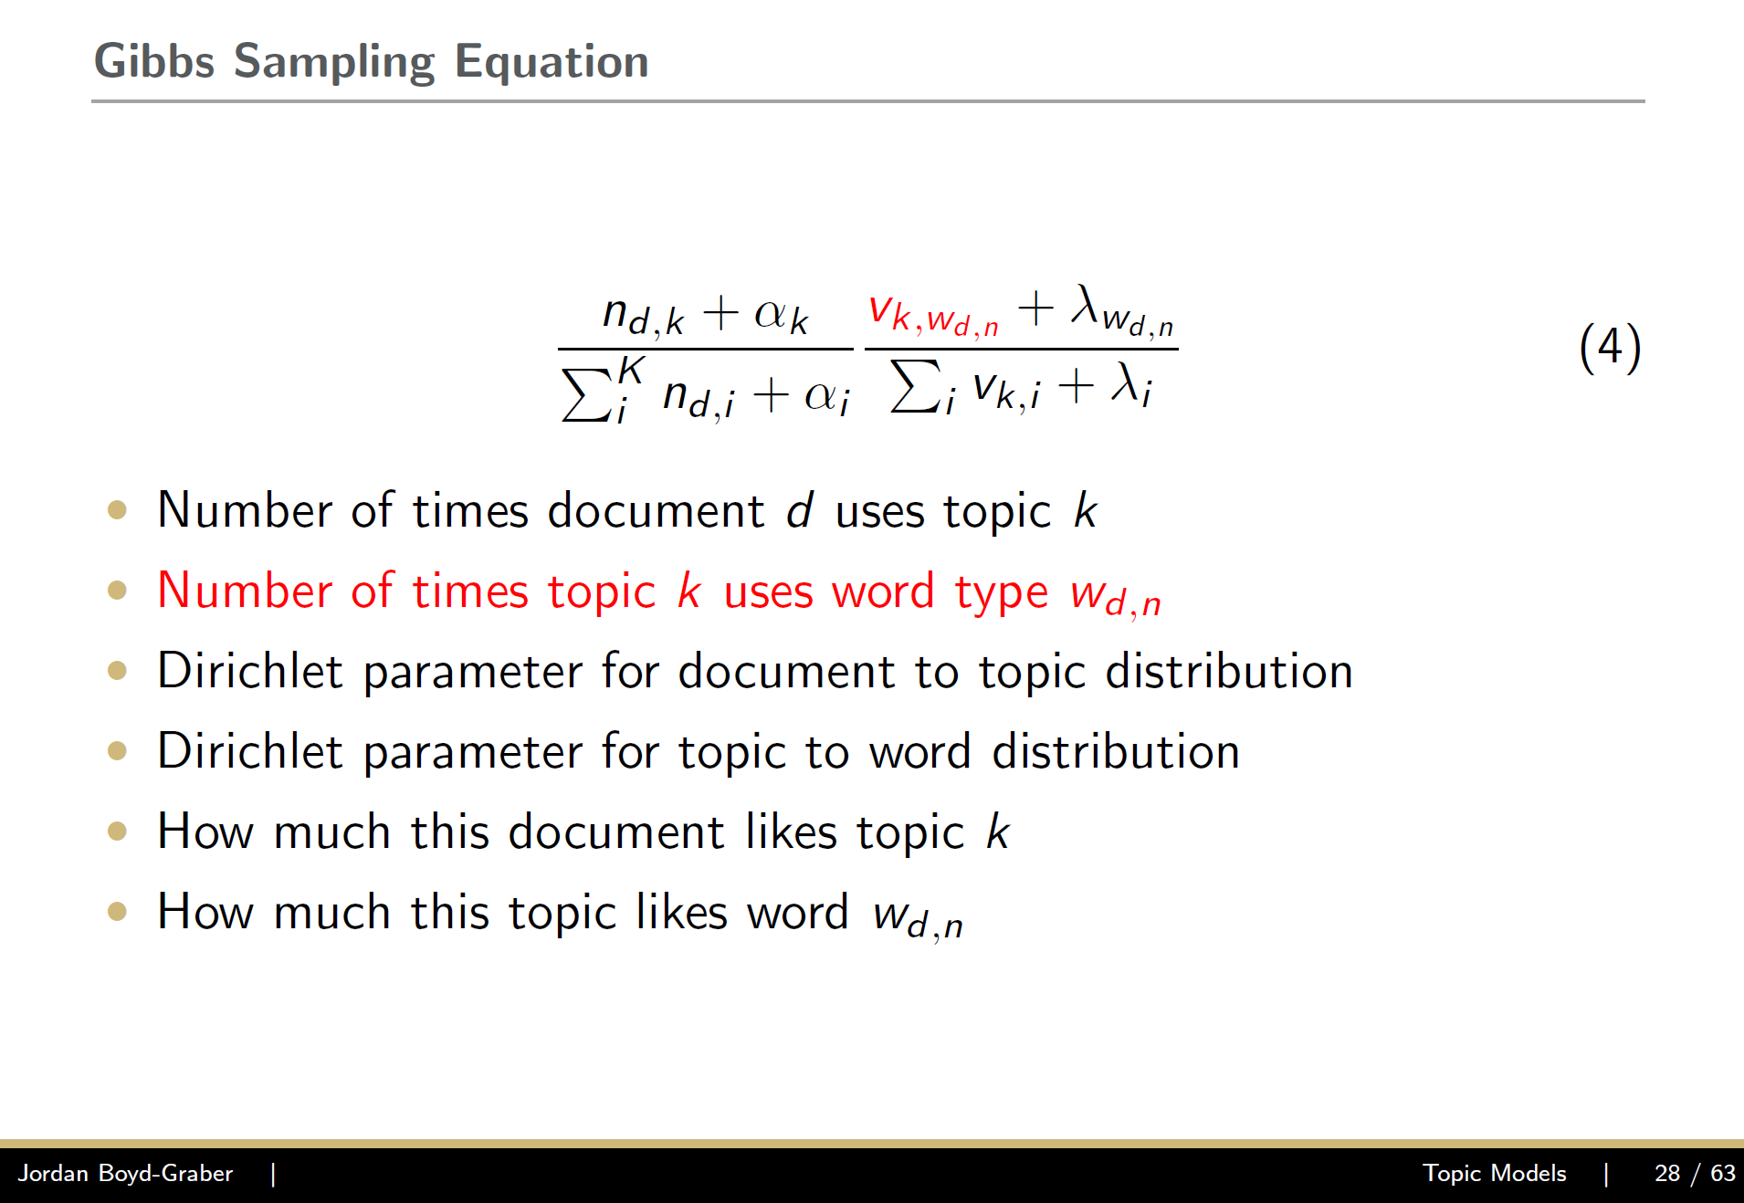

Slide 76
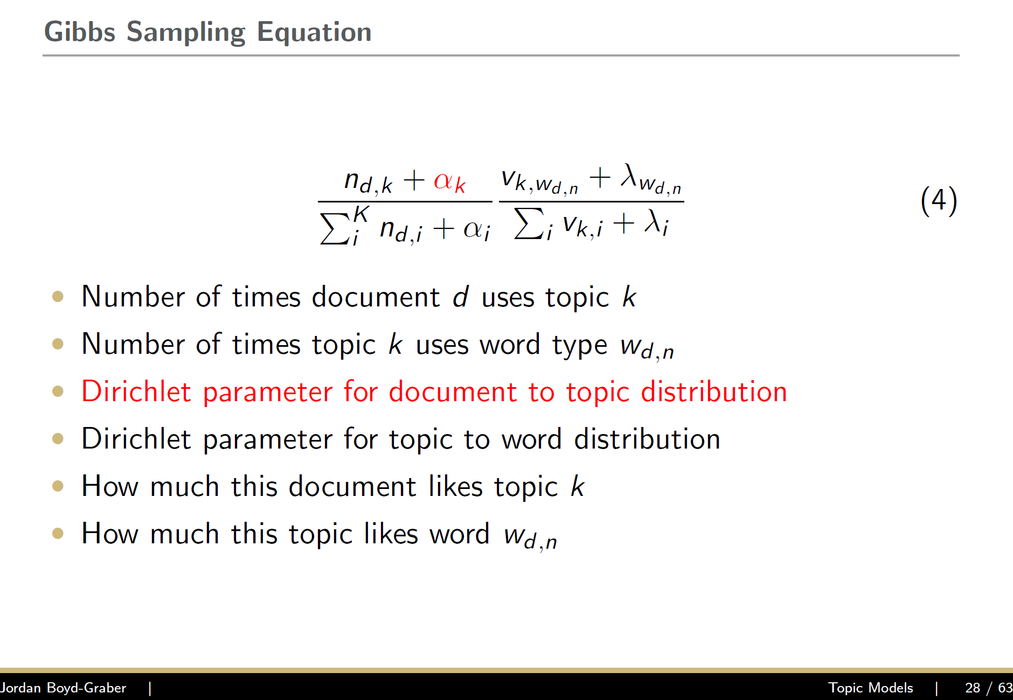

Slide 77
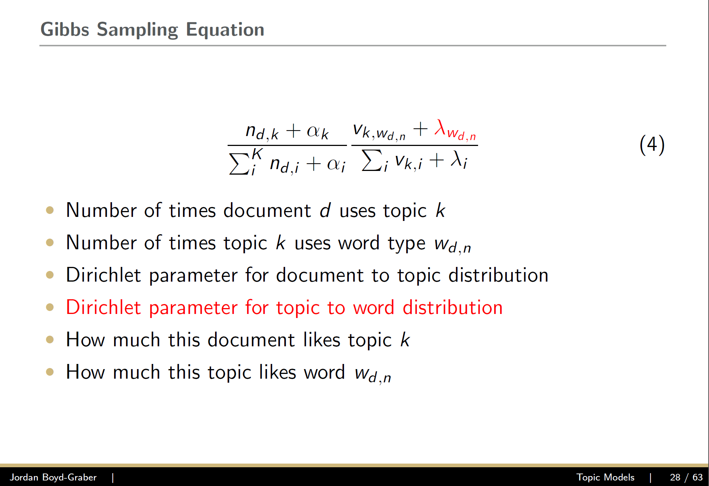

Slide 78
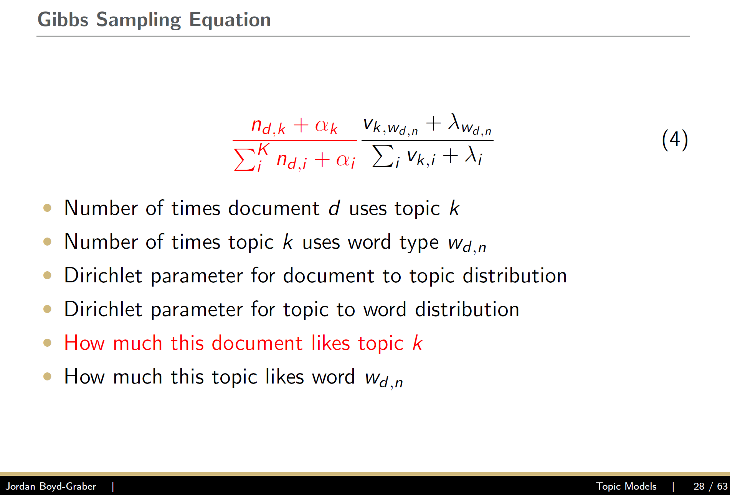

Slide 79
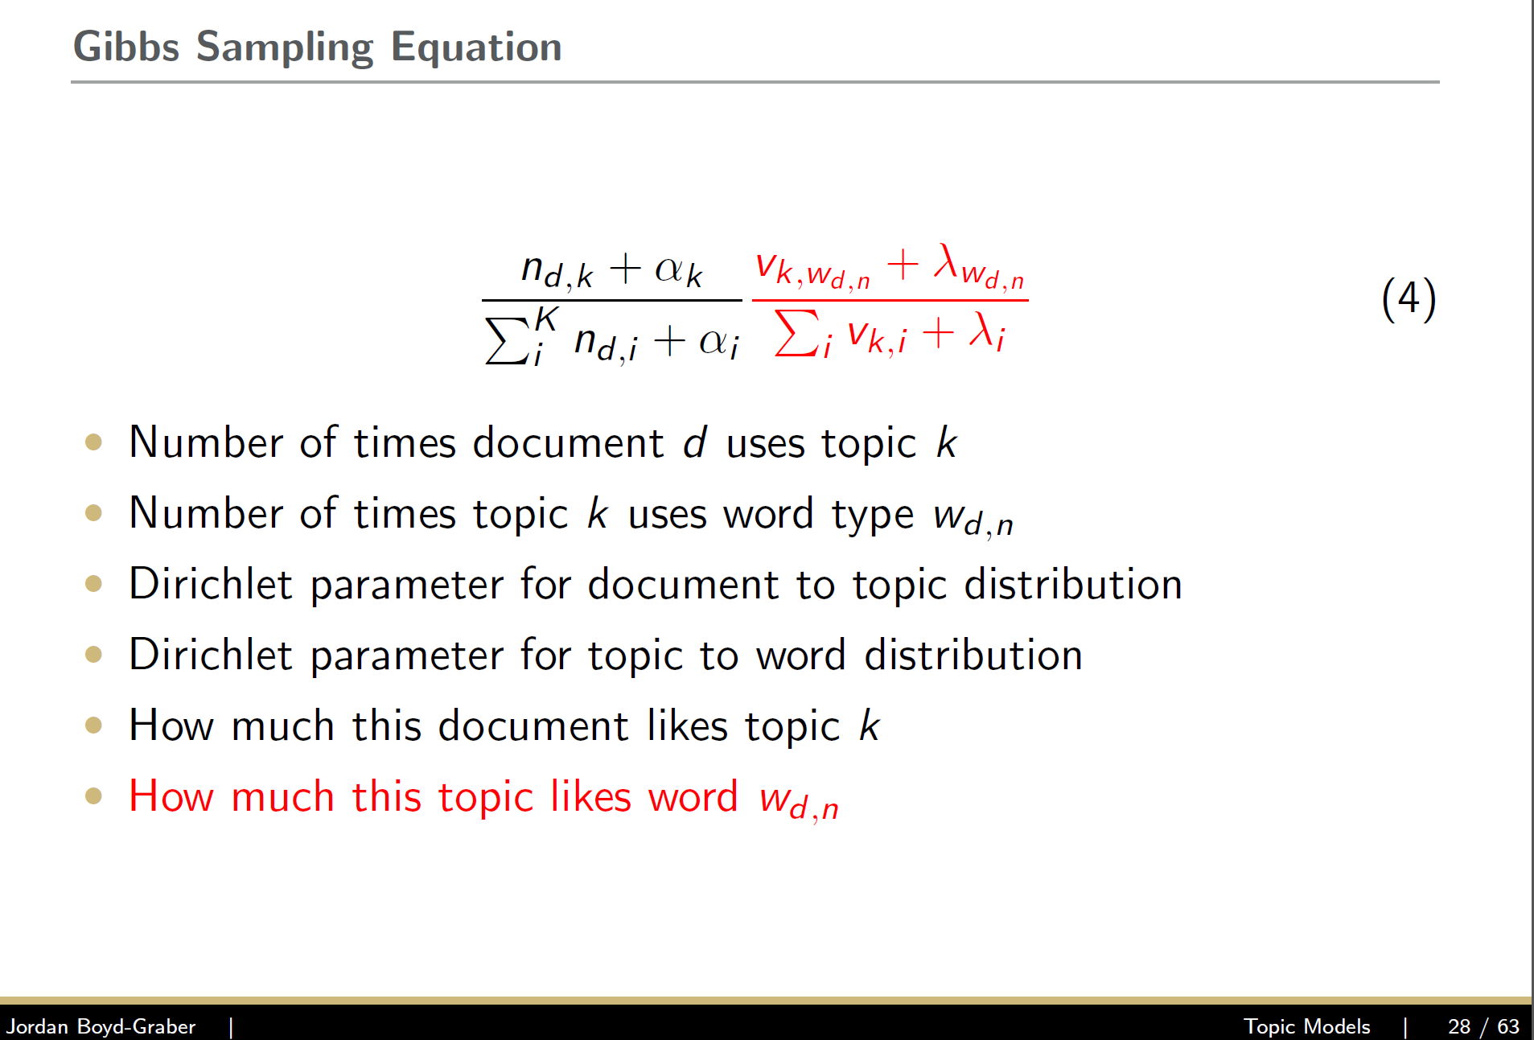

Slide 80
Outline
Motivation
Definitions
Processing text data
Methods
Evaluation
Approaches and Applications

Slide 81
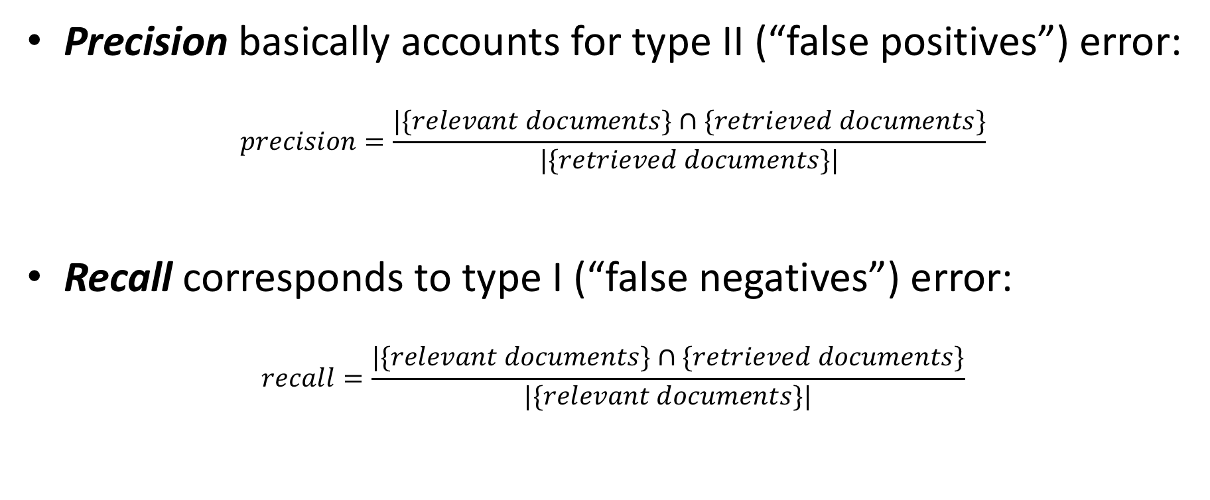
Precision and recall
Precision basically accounts for type II (“false positives”) error:
$$precision=\frac{|\{relevant documents\}∩\{retrieved documents\}}{|\{retrieved documents\}|}$$
Recall corresponds to type I (“false negatives”) error:
$$recall=\frac{|\{relevant documents\}∩\{retrieved documents\}}{|\{relevant documents\}|}$$

Slide 82
Accuracy
(Number of correct predictions)/(Number of total predictions)

Slide 83
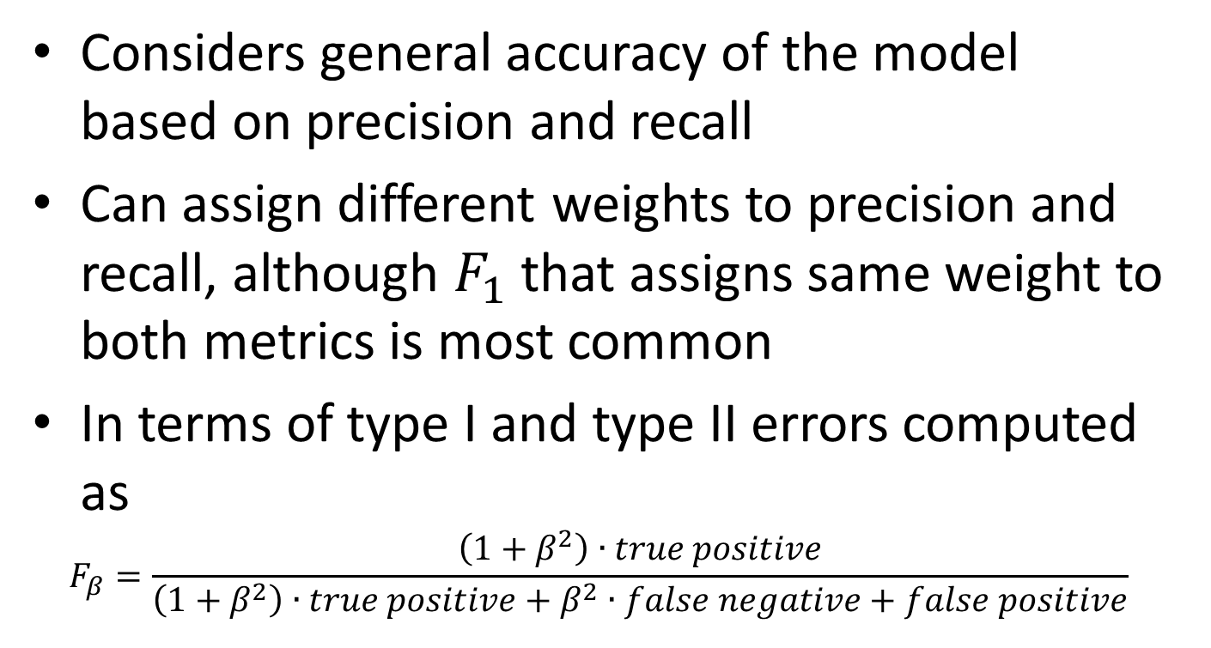
F score
Considers general accuracy of the model based on precision and recall
Can assign different weights to precision and recall, although $F_{1}$ that assigns same weight to both metrics is most common
In terms of type I and type II errors computed as
$$F_{β}=\frac{\left(1+β^{2}\right)∙true positive}{\left(1+β^{2}\right)∙true positive+β^{2}∙false negative+false positive}$$

Slide 84

Results: Model Performance
Source: Cuffe et al. US Census Bureau
Notes:
Again formatting needs to be done. Some notes
Blank entries could be dropped, they indicate that we didn’t have any data that could pass disclosre in that NAICS code
There doesn’t seem to be a clear pattern of benefit of the types/text/ss4. In some NAICS codes the ss4 is better (23 (construction), 48/9 (wholesale)), others the google review/website text is better (almost all the rest)
Interestingly, the google type tags sometimes do WORSE than the text (accomdation, other servies (72 and 81))

Slide 85

Results: Comparing to Autocoder
Source: Cuffe et al. US Census Bureau
Notes:
Autocoder comparison—
Show the overall accuracy of the ensemble of models compared to the autocoder
Autocoder: about 71% correct, 16% incorrect, remainder not coded
Us: about 80% correct, 20% incorrect (when weighting for size of NAICS codes)

Slide 86

Results: Impact of Textual Information
Source: Cuffe et al. US Census Bureau
Notes:
This is ordered (from left to right_) from most to least overlap between the words in Google and the SS4. Not much there, in terms of benefit to our models having a consistent pattern.
Note: Wholesale trade is where the typ tag was the most useful data type.

Slide 87
Weaknesses
Survivorship bias:
Lower than expected match rate.
About 30% of all restaurants fail within a year.
Changes over time
Business can change NAICS codes over time.
Websites more immediate source of information.
Cleaning of Website text.
Better parsing and understanding of errors on NLP models.

Slide 88
Outline
Motivation
Definitions
Processing text data
Methods
Evaluation
Approaches and Applications

Slide 89
Key takeaways
Text is a useful resource to answer policy and research questions
Text data is very diverse and requires substantial processing
Data cleaning and processing are critical to success
The choice of the right method depends on the question and application
Evaluation is key to robust and valid results

Slide 90
What can text mining do?
Capability | Description | Maturity
Classification | Classification of a document into one or more previously defined content categories. (e.g. Classify incoming emails as personal, business, news article, etc.) | High
Word Clustering / Synonyms | Finding groups of words that are similar to each other. Depending on the strictness of the definition of similarity, similar words can be synonyms (IBM, Deep Blue) or companies in similar industry (Oracle, Teradata) | Low
Topic Detection / Clustering | Finding emerging or existing topics in large amounts of text data. Clustering news articles can help detect emerging topics. | High
Opinion & Sentiment Analysis | Detection of sentiment and opinions in different levels of granularity (word, sentence, message). | Medium
Named Entity Extraction (People, Locations, Organizations) | Recognition, tagging, and extraction of named entities of type Person, Location, and Organization. Typically limited to proper nouns and not much customization possible. | High
General Extraction (Entities, Events, Facts, Relationships) | Recognition, tagging, and extraction of specified classes of words /phrases as an entity (client, competitor, company), event (acquisition), relationship (John King works for MSFT) | Low
Search | Ranked retrieval of a document or component based on the presence of one or more supplied search terms. | High
Visualization | Visualization of text data and /or visual mashups combining text with other forms of data (maps, networks, etc). | Medium
Summarization | Summarization of a document, intended to produce a readable abstract of the source document which captures salient points using fewer words. | Low
90
Notes:
Add entity extraciont separate

Slide 91
Python Toolkit - NLTK
Book at http://www.nltk.org/
Useful scripts in nltk-trainer

Slide 92
Online Resources
Interactive clustering tool Ontogen: ontogen.ijs.si
Tutorial at http://eprints.pascal-network.org/archive/00000017/01/Tutorial_Marko.pdf
Online lectures at videolectures.net
List of commercial software http://www.kdnuggets.com/software/text.html

